Slide 1
Building Trust EAVI Campaign
Lama Jaghjougha. project officer at EAVI (European Association for Viewers Interests)

Slide 2
What is EAVI?
EAVI – the European Association for Viewers Interests is an international non-profit organisation registered in Brussels which advocates media literacy and full citizenship. EAVI supports the adoption of initiatives that enable citizens read, write and participate in public life through the media

Slide 3
In particular EAVI aims to:
Promote full citizenship and media literacy
Develop and disseminate best practices in media use
Forward the interests of citizens by engaging the EU institutions as media policy stakeholders

Slide 5
Building Trust
This campaign intends to counter these wide-spread stereotypes by educating the public and highlighting the techniques used that can easily change the context of situations and news reporting.

Slide 6
Building Trust
EAVI’s ‘Building Trust’ online campaign is a clarification surrounding the effect of negative reporting that can occur by presenting a distorted and often negative image of migrants by the media and social media platforms.

Slide 7
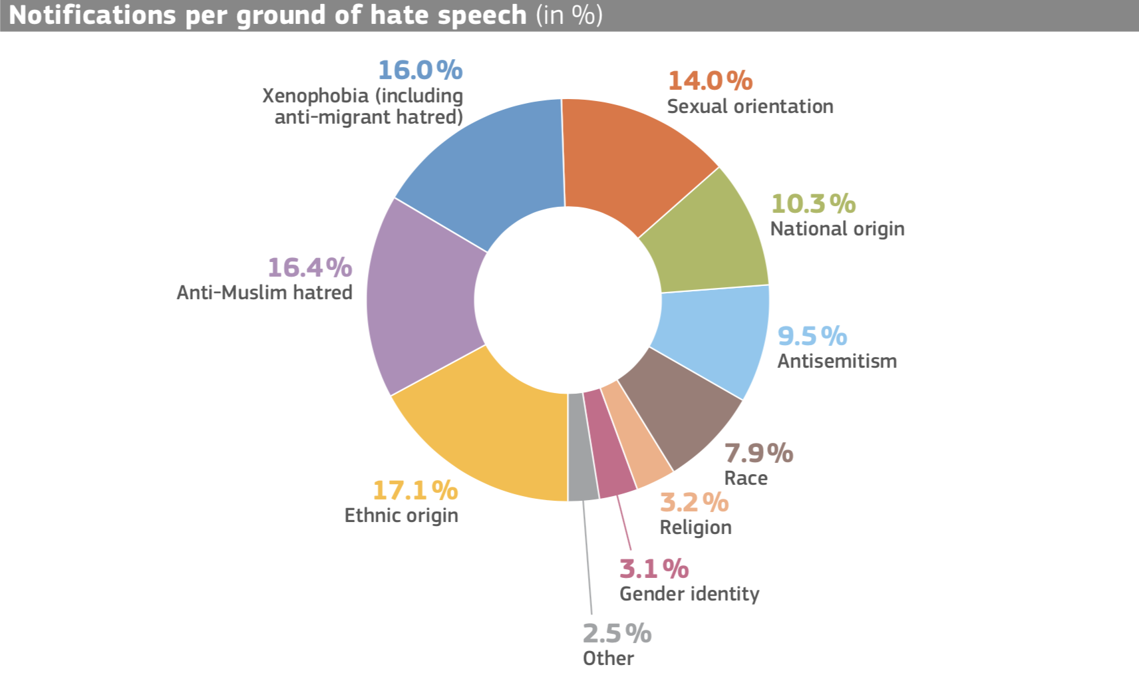
Code of Conduct on countering illegal hate speech online - January 2018 - European Commission

Slide 10
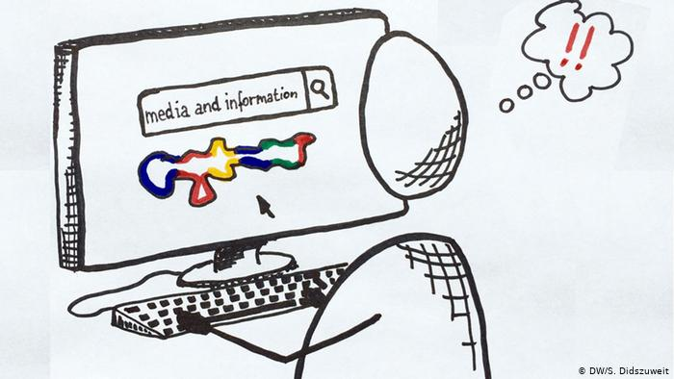

Slide 11
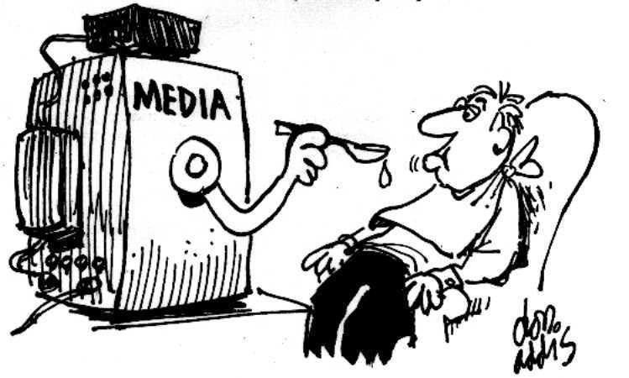

Slide 12
For migrants and refugees when they tell their story, what are these six questions you may encounter?
The six questions?
1. Who .. Who played the role in the occurrence of the event.
2. When the time of the event.
3. Where? Where is the event.
4. What? What happened?
5. How .. Event Details.
6. Why .. priorities or backgrounds of the event.

Slide 13
For migrants and refugees when they tell their story
Find your focus and define your purpose (What and Why)
What is your story about? This is related to the purpose of your story and is similar to a story headline. Balance negativity with positive messages.
In any case keep it short (How)
Consider that the usual attention span when watching online contents is not very long, you only have a few moments to grab a viewer’s attention and engage them, so try to keep it short (2 -7 min).

Slide 14
Learn storytelling techniques. If possible, start an online course or self-learning.
https://www.coursera.org/courses?query=storytelling
Find your own language (How)
Social media and digital storytelling offer possibilities to tell stories without using words. In any case, consider possible language barriers – using simple language can help overcome cultural barriers – think about who you want to reach. Use free online resources.
Get your story out (Where)
For example, by setting up a blog or build personal relationships with relevant journalists and publishers. It can be about ‘who you know’. Also, develop relationship with civil society organisation and with local media agencies to get support.

Slide 15
Do not do ..
Don’t tell a purposeless story with no meaning behind it.
Do not play up the self -pity. It can be counterintuitive and alienating. Be sure there is a relevant, informative value to your story.
Don ́t think too big
Find and focus on simple stories or choose only one part of the larger story – small stories can be as impressive as big ones, but are easier to produce and often get more attention.

Slide 16
How to Check Online Information Sources
Direct Investigation of Information:
Through the old method. Pick up the phone and call people, make an effort to contact these people even if you know who posted the news online.
2. Adopt witnesses as directly as possible. Do not publish news that has not been verified by trusted sources.
3. Check the background of the source on social media and this is done through:
Check the credibility of the person: When was the account created? Be wary of new accounts. How many updates are released? Is it a regular user account? Do they have friends or followers? Are they following other people? Do they have any random observers?
4. You can also ask your followers to help verify information.

Slide 17
To verify the website information:
Check the site page on the Google Rankings page: If the page rank is high, it probably means that the site is trusted and has been referred to earlier.
2. Search blogs and news to see if the person or company has talked about this before.

Slide 18
Check photos:
Compare the location of the photo with maps and photos in the area. Study weather reports and shadows to ensure that the conditions described correspond to the date and time of the alleged image.
2. Check out clothes, buildings, languages, banners, vehicles and other image or video elements to see if they support what the image claims.
3. Use the TinEye search engine to search for images to see where the image came from, how it was used, whether it was a modified version of an existing image, or if it was available at a higher resolution according to the site.

Slide 19
اين يمكن ان تبلغ في حين التعرض الى اي من خطاب الكراهية في بلجيكا؟
Where can you report to any hate speech in Belgium?
Interfederal Centre for Equal Opportunities (UNIA)
Institute for the equality of women and men
MRAX (Movement Against Racism, Anti-Semitism and Xenophobia)
La Voix des Femmes
Police
المركز الدولي للفرص المتكافئة UNIA))
معهد المساواة بين المرأة والرجل
MRAX حركة مناهضة العنصرية ومعاداة السامية وكره الأجانب
صوت المرأة
الشرطة

Slide 20
Visit our websites
eavi.eu
buildingtrust.eu

