Slide 1
VDAB
Vlaamse Dienst voor Arbeidsbemiddeling
“Flemish employment service”

Slide 2
Our Mission
We help *inhabitants of Flanders to develop their careers themselves. (To empower jobseekers)
As a director, we create the inspiring network for this.
As a service provider we encourage citizens to develop their talents and competencies to the maximum.

Slide 3
Target Audience
*inhabitants of Flanders:
Flemish Citizen
Immigrant & Asylum seeker
Recognised Refugee
Students
Jobseekers who live outside of Flanders (Brussels or Walloon region) can not register. They can follow a training program of VDAB if Actiris or Forem gives them a document of interregional mobility.

Slide 4
Our mission
With a view of lifelong and sustainable integration into the labor market of job seekers and employees.
Your job of today is not necessarily your job of tomorrow
Invest in your future!
Integration through employment
Interregional mobility

Slide 5
Our Mission
Ensure, organize and promote employment
Jobfares: To be found on our website vdab.be
Social Media: VDAB page on Facebook, Linkedin…
Talentfares: Open doors of our trainingcomplex (Talentenbeurs)
Company visits
Networking: Integration Office, OCMW, schools

Slide 6
Our mission
Guidance and training in the interests of employers, employees and job seekers
Our focus is on training programs that lead to jobs with a likelihood of employment after finishing the course (nursing, IT programming, construction engineering)
Employers are not able to find enough candidates for most of the previously mentioned jobs

Slide 7
VDAB Website
Videos about VDAB in other languages
Français
Deutsch
العربية
Berbers-Tarifit
Italiano
Bŭlgarski-български
Pashtu
Dari
Polski
Românesc
Russkiy-Pусский
Español
Türkce
Website with information for Higher Educated Foreign Speaker
https://www.vdab.be/anderstalig-hoogopgeleid

Slide 8
VDAB website
Info about working and studying in Flanders for Higher Edcuated Foreign Speakers (HOA)
https://www.vdab.be/anderstalig-hoogopgeleid
Advice about working and/or studying on your Diploma level
Go the website
Click on the green frame that says “Extra hulp nodig (extra help necessary)”
Choose your region: Antwerp, Limburg….
Book an appointment on the website through the “youcanbookme” system

Slide 9
Tips before starting!
Get your diploma recognized!

Slide 10
Diploma Recognition
Jobseekers with an integration-contract ( Elligible untill 3 years after signed integration contract)
Contact your integration consultant of the Integration Office
Ask for an appointment with a consultant for diploma recognition. Free!
Obtain additional information about your diploma:
List of marks, thesis ..
The Agency sends NARICC (Flemish Government all your documents and follows up the procedure

Slide 11
Nederlands leren
What to do after my diploma recognition?
Studying Dutch
A) Study Dutch until level 2.4 through the integration office
B) Follow a Dutch course for Higher Educated Learners at ILT Leuven or Linguapolis Antwerpen
2. Follow a VDAB course for Foreign Speakers
3. Start to apply for jobs

Slide 12
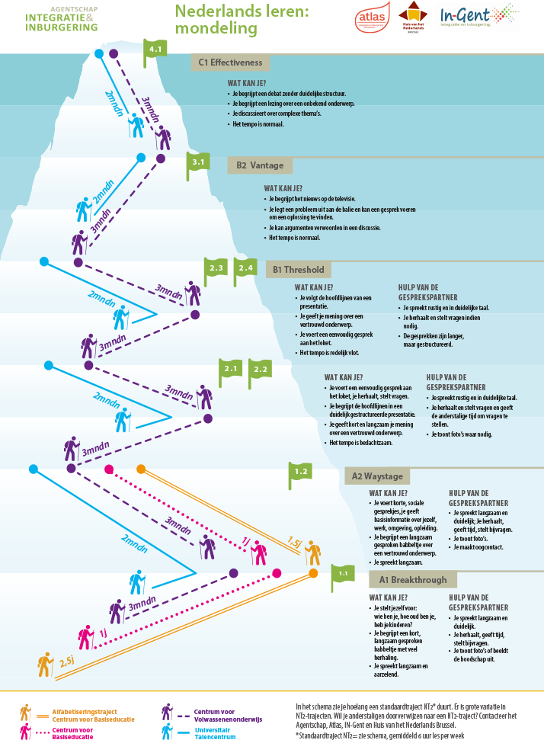
Studying Dutch

Slide 13
VDAB courses
Every VDAB training program is instructed in the Dutch language.
Training programs designed for Foreign Speakers
Training programs for Dutch speakers with a high proficiency (minimum level 2.4)
IBO: Training on the job. Employer is obliged to hire you with a contract after the training program
BIO: Internship to see if job fits you

Slide 14
Different sectors

Slide 15
Healthcare and education
Healthcare
Why work in healthcare?
The region of Flanders has a shortage of qualified nurses and healthcare professionals (5380 open vacancies and only 942 unemployed skilled workers)
A stable job that provides security
Growth possibilities ( Employers are willing to invest in your studies to achieve a Graduate degree in Nursing)
Working close to home. Retirement homes and hospitals have a shortage of staff in every region in Flanders

Slide 16
Healtcare trainingprograms for Foreign Speakers
Zorgned+ en Prior Education Social Profit for foreign speakers (VOSPA) Code 904306

Slide 17
What is Zorgnet+?
Zorgnet+
Combination of learning Dutch specific for working as a care giver/care professional and learning theory and practice of healthcare
Obtaining a certificate and VISA number to work as a registered Caregiver/professional

Slide 18
Zorgned+
Requirements to be enrolled for the course Zorgned+
You are registered as a job seeker at VDAB, a foreign speaker and are currently learning Dutch
You have sufficient knowledge of the Dutch language (oral and written) to follow the course; entry level 2.1
You are at least 18 years old or will be in the year in which the course starts;
You are medically fit to follow the training and then to practice the profession. A medical examination is planned after registering for the training and the profession.

Slide 19
Healthcare
Prior Education Social Profit for foreign speakers (VOSPA)
Would you like to take care of other people?
Would you like to work in the healthcare sector?
And is your Dutch not yet strong enough to apply or study?
Or are you still unsure which healthcare sector suits you? Then this training is for you!

Slide 20
Prior Education Social Profit for foreign speakers (VOSPA)
What do you learn during this course?
Intensive Dutch course (Full-time) for 21 weeks
You will learn vocabulary and master conversation skills that are focused on the healthcare-sector
Specifically for the social sector (with an emphasis on nursing, care and caring)
You receive personal guidance: discuss your personal growth and results;
You learn to work on preconditions such as childcare, mobility, family organization, and so on; You will also receive lessons in communication and learning to study.

Slide 21
Prior Education Social Profit for foreign speakers (VOSPA)
After the training you dare to speak more Dutch,
You know what working as a nurse, caregiver or care professional is
You understand better how people communicate with each other

Slide 22
Geïntegreerde bediende opleiding
“ Integrated employee training course”

Slide 23
Business Support and ICT
“ Integrated employee training course” Code 602300
For who?
You are good at administration, you like to organize and you like to take initiative? Then the job of a clerk is something for you.
As a clerk, you organize and manage the administration in a company.
You also follow up internal files and customer files.
During this training you learn the necessary administrative Dutch.
The structure of a company, invoicing, purchase and sale of goods, in short, everything you need to find a job as an administrative employee.

Slide 24
Integrated
employee course
What you will be learning during this course:
Purchase and sale of goods;
The operation of a warehouse;
Invoicing;
Dealing with customers;
Communicate orally and in writing according to the job (Dutch, French, English);
Working with office;
Apply business administration (trade documents, ERP, invoicing);
Customer-oriented attitudes and social skills.

Slide 25
Integrated
employee course
How long does the training take?
The training consists of two parts. Part 1 lasts a maximum of 16 weeks (full-time), depending on your starting level and your pace. Part 2 takes a maximum of 20 weeks, depending on the modules you choose.
You get a tailor-made program and you discuss that with the instructor. You work independently and follow an individual learning trajectory: you acquire knowledge online and you participate in workshops.

Slide 26
Integrated
employee course
You can follow the course if you:
Are a registered job seeker at VDAB
Have a minimum entry level A2 (RG 1.2)
To pass a entry exam in Word, Excel and basics of French and English
Previous experience in Administration or degree in Administration from your country

Slide 27
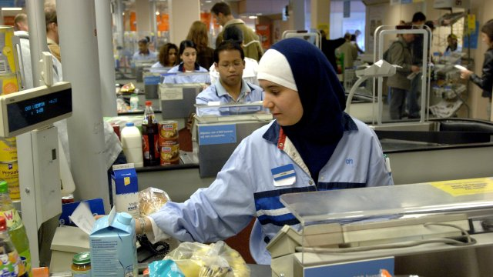
Dutch for Sales+ training program Sales Assistant or Branch holder

Slide 28
Dutch for sales
What you will be learning in this course?
Dutch for Sales (Code 950854)
In this course you learn the Dutch that you need to work as a store clerk or fashion seller.
You learn how to listen to instructions, answer questions from a customer, hold a conversation at the cash register, etc.
In addition, you also learn how to apply and work on your pronunciation of Dutch.

Slide 29
Shop assistent
Shop assistant
Selling techniques
Giving customer advice and how customer-friendly are
Supplement racks / products correctly
Inventory management
Working with the cash register
Dealing with various payment methods;
Theft prevention

Slide 30
Branch holder/manager
Branch holder/manager (Code 505301)
Apply merchandising techniques;
Theft prevention;
Inventory management and distribution;
Replenishment techniques;
Lead and manage a team;
Prepare and organize a work schedule;
Insight into financial management, pricing and VAT

Slide 31
Prior education software developer for foreign speakers (Code 750406)

Slide 32
Prior education software developer for foreign speakers
For who?
Always wanted to know what programming means? Then why not follow basic training to see if it is for you! In this course you test your knowledge, capacities and attitudes against the requirements that are set in practice. If there is a programmer in you, you can then start your finality course: .NET, Java or PHP and make it your profession.
For how long ?
6 months

Slide 33
Prior education software developer for foreign speakers
Requirements:
To have experience with computers and their applications;
To have sufficient knowledge of English to read and understand a technical text;
Competence and thinking level of secondary education (can also be demonstrated by professional experience);
Learning ability, have analytical skills, being able to work independently and collaborate.
A basic knowledge of programming is a huge advantage.

Slide 34
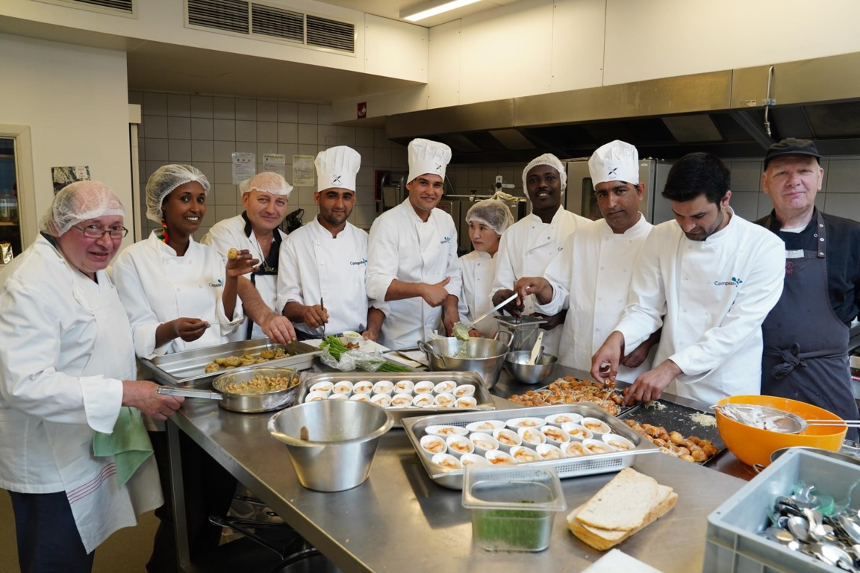
Kitchen Aid (Code 403600)

Slide 35
Kitchen Aid
For Who?
Would you like to work in the kitchen, but do you lack the necessary knowledge or experience?
Are you flexible and motivated to learn something? Then the practice-oriented Kitchen Assistant course is for you.
In 10 weeks you will learn the basics of working in a kitchen. A short internship is possible during the course.
After the training you do an internship of 4 weeks in a professional kitchen. This way you get professional experience.

Slide 36
Kitchen Aid
What are you learning?
Hygiene rules;
Cutting techniques;
Basic preparations and cooking techniques;
collaborate with others;
Prepare salads, snacks and soups;
Make potato and pasta preparations;
Initiation cold, warm kitchen and desserts.

Slide 37
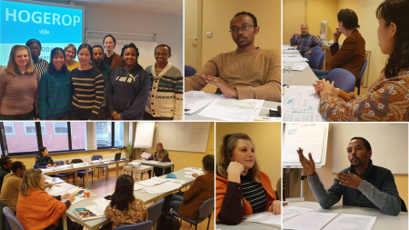
Hogerop /Higher-Up (Code 950837)

Slide 38
Hogerop
What is Hogerop?
Professional Dutch and job application training for highly educated foreigners (minimum Bachelor Degree)
For 10 weeks you will be intensively guided to find a job at your level. Our training includes group lessons, workshops and there is room for individual guidance. We will fine-tune your CV, improve your cover letters and practice the interviews. We look for suitable vacancies together with you and we perform a thorough vacancy and job analysis. You learn to present yourself professionally via your elevator pitch, also on the basis of a video message.

Slide 39
Hogerop
We work intensively with your LinkedIn profile: learn to network and search for vacancies. You follow workshops on: 'talents, competencies, job scope, corporate cultures and networks’.
You learn how to use the telephone, send emails, participate in a meeting and give a presentation. During the training you will work intensively on your professional Dutch. You will be immersed in a language bath and learn to write and speak form correctly.

Slide 40
Hogerop
For whom?
Foreign Speakers with a Bachelors, Masters, ManaMa, PhD degree
Apply with your diploma, within your expertise
You have a realistic job target
For IT and laboratory technicians: minimum level Dutch 2.1
For the other sectors: from level 2.2 / 2.3
Foreign speakers willing to apply in Dutch

Slide 41
How to register for a VDAB course?
Go to our website : https://www.vdab.be/opleidingen
Type in a keyword or Code: Exemples of keywords; Bediende-opleiding, Nederlands voor verkoop, Vooropleiding Social Profit voor Anderstaligen.
Click on “Vraag deze opleiding aan”

Slide 42
VDAB & partners
AZO: Becoming self-employed as a refugee/newcomer
Duo 4 a job: links unemployed young people with a migrant background from outside the EU to people over 50 who use their experience as a volunteer to guide these young people to work.
Mentor2work: Same principle but for every age of unemployed people
Diana@work: For women with a long distance to the labour market.
IVAN: Intensive Preparational Year Intensive Dutch in Leuven to study a Bachelor at Hogeschool UCL.

Slide 43
AZO
Website becoming Self Employed
https://projectazo.be/
To enroll for an infosession:
https://projectazo.be/en/infosessies-nl/

Slide 44
Mentor Programs
Mentor2work
mentor2work@minderhedenforum.be
DUO for a job
brussels@duoforajob.be

Slide 45
Laila Bagar
Arbeidsconsulent Vilvoorde
Diana@work
0485 00 71 26
laila@vzwaif.be
Schaarbeeklei 49
1800 Vilvoorde

Slide 46
Intensive Preparational year Dutch language
IVAN
Webpage: https://www.ucll.be/studeren/student-aan-ucll/begeleiding/ivan-voorbereidingsjaar
Email:
bie.strypens@ucll.be

