Slide 2
What will we learn today?
What you need to know before getting started:
How to work as refugee
The Belgian job market
Contracts and specific employment regulations in Belgium
How to get started:
where to look for a job
how to write your CV
how to prepare for an interview

Slide 3
How to work as refugee
A refugee (i.e. a person who obtained refugee status, completely different rules apply pending the procedure) does not need a work permit and has access to the labour market under the same terms as Belgian citizens, which includes the same:
Minimum Wage
Maternity Leave
Maximum Working Time
Requirements for Contracts

Slide 4
CONCLUSION OF AN EMPLOYMENT CONTRACT
What types of employee?
Blue-collars employee: if you exercise a "manual" function (e.g., deliveries, driver, building sector, etc.).
White-collar employee: if you exercise an "intellectual" function (e.g., being behind a computer, preparing documents, etc.).

Slide 5
What type of contract?
Fixed term contract (CDD): the duration of the contract (both start and end date) is determined in advance
Indefinite contract (CDI): only the start date is determined in advance
Interim agency contract: the contract has a temporary duration and is signed with a third-agency (e.g., manpower, tempo-team, etc.)
Professional immersion agreement (CIP): The professional immersion agreement is an internship agreement, which main objective is to provide you with practical experience and professional knowledge and skills. The immersion agreement is not an employment contract and therefore the employer will not pay a salary. However, as an intern, the employer has to pay an allowance (+/- 800 EUR/month)

Slide 6
What will be provided in your employment contract?
Working time regime
How many hours per day and/or per week you are expected to perform
Depends on the sector in which the employer is active
In general: 38 hours per week – 5 days per week – 2 days of rest
Remuneration
For blue-collar employees (i.e., "manual work") : hourly remuneration paid twice a month (minimum of 9,67 EUR gross per hours)
For white-collar employees : monthly remuneration paid once a month (minimum of 1.593,81 EUR gross)
Refund of the travel costs
The employer has an obligation to contribute to the travel costs of its employees who use public transport (train, tram, metro, bus) to travel between home and work. In most cases, it is not required to intervene in the travel expenses of workers who use their personal cars to get to work.

Slide 7
What will be provided in your employment contract?
Holidays
Employees are entitled to 20 days of legal holidays and 10 days of bank holidays
10 paid bank holidays : 1 January, Easter Monday, 1 May, Ascension Day, Whit Monday, 21 July, 15 August, 1 November, 11 November and 25 December.

Slide 8
Rights during the employment contract
Illness
Employees can become ill in Belgium and will receive paid leave in case of an employment contract of indefinite duration or a fixed term employment contract
Employee must notify employer and provide medical certificate to employer
→ the rules to be respected are indicated in the work regulations

Slide 9
Rights during the employment contract
Pregnancy
Mothers have 15 weeks paid pregnancy and maternity leave (5 before the childbirth) and 9 after the childbirth
Partners have 10 days of paid leave
Pregnant employees are protected against dismissal

Slide 10
Termination of employment contracts
By who?
By employer
By employee
How?
By performing a notice period
By payment of an indemnity in lieu of notice
Without notice period or indemnity in lieu of notice : termination for serious cause (exceptional)
Rules?
Different rules apply for employment contracts of indefinite duration or definite duration

Slide 11
Termination of employment contracts
Termination for serious cause
Serious cause? Only in case of serious facts which make the performance of the employment contract impossible (e.g. Theft, fraud, etc.)
Consequence?
Immediate termination of the employment contract
Without payment of indemnity in lieu of notice or notice period (!!)
No right to unemployment allowances after termination (!!)
How?
Strict conditions: check with trade union in case of doubt

Slide 12
Termination of employment contracts : unemployment allowance
Unemployment insurance is a branch of social security whose organisation and management has been entrusted to the National Employment Office (ONEM).
The principle of unemployment insurance tends to grant benefits to replace lost professional income, in the case of a worker who has been dismissed
One of the mission of the ONEM is to establish and verify whether the unemployed person meets the conditions for admission and granting of unemployment benefits
Conditions:
Having the completed the waiting period for accessing the regime
Having been involuntarily deprived of work and remuneration
Be and remain registered as a job seeker with the competent regional employment service (FOREM, Actiris, Arbeitsamt or VDAB)
Be and remain available for the job market
Be able to work
Residing in Belgium

Slide 13
Who to contact in case of doubts during or after the working relationship ?
Question about your rights during your relationship (e.g., pregnancy, sickness, etc.), the amount of your indemnity in lieu of notice, the dismissal for serious cause ?
Contact:
trade union organization
"bureau voor judische bijstand" – "bureau d'aide juridique"
Possibility for pro deo assistance in case low income

Slide 14
Know your rights pop-quiz
My employer asked me if I want children. After I said yes he told me that if I become pregnant he will terminate the employment contract. Can he do this?
A: Yes
B: No

Slide 15
Know your rights pop-quiz
I want to sign my employment contract but some important information such as my remuneration, my function or the working schedule are not indicated. Should I sign this document?
A: Yes
B: No

Slide 16
Know your rights pop-quiz
My employer says I was late to work once and he can terminate the employment contract for serious cause. Is he right?
A: Yes
B: No

Slide 17
Know your rights pop-quiz
My employer told me I have to come work on Sunday and I will not get paid for this work because there is a lot of work and me and my colleagues did not work hard enough during the week. Is this allowed?
A: Yes
B: No

Slide 18
How to get started:
Finding a job in Belgium

Slide 19
Where to look for a job?
Public employment office:
Actiris for the Brussels-Capital region
VDAB for Flanders
Le Forem for the Walloon region
Search online:
Monster.be
Be.indeed.com
Etc.
Interim agencies: Adecco, Manpower, ASAP, Secretary+...
Ask friends in your network

Slide 20
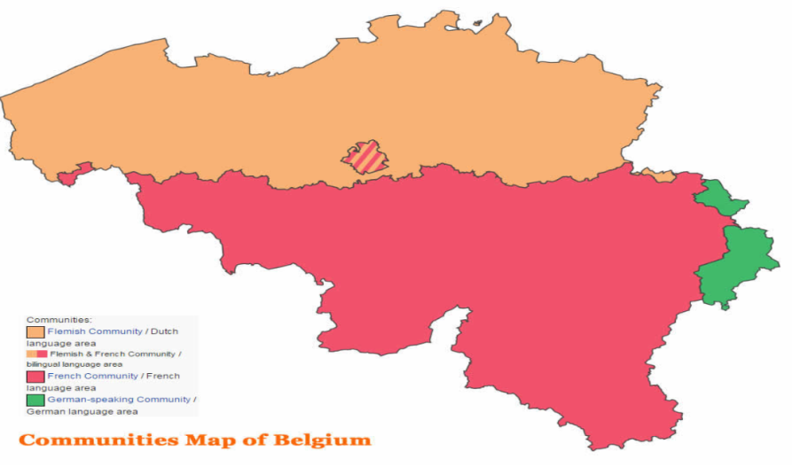
Language requirements
There are 3 official languages in Belgium
Dutch, French, German
The Brussels-Capital region is bilingual (French + Dutch)
Expectations: speak the language of the region in which you’d be working
In some cases, mainly in international companies, English may be sufficient

Slide 21
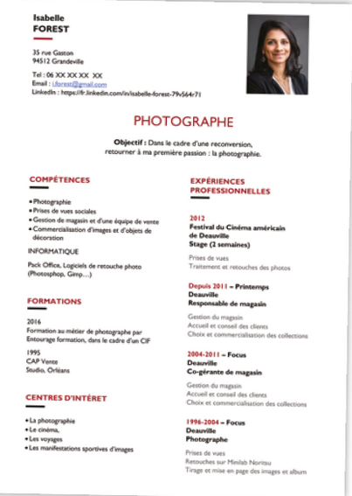
Curriculum vitae (“CV”)
Your curriculum vitae should include:
Basic Personal details
Contact information
Education
Work experience
Skills (computer skills, foreign languages);
Personal interests

Slide 22
Curriculum vitae (“CV”)
DO | DON’T
Use the same font | WRITE IN CAPITAL LETTERS or mix fonts
Max 2 pages | Put unnecessary information
Be Honest | Lie on your CV
Double check | Make spelling mistakkkkes
Chronological order | Give too many details
Include an email address that looks professional + a local phone number

Slide 23
The Job Interview
Congratulations, you have been invited to a job interview.
Remember the following:
Be on time
Dress according to the dress code
Prepare yourself : do researches
Answer the questions politely
Ask questions yourself.

Slide 24
The Job Interview
Questions that are not allowed
Medical questions
Criminal record/past
Nothing personal that can lead to discrimination
Age, single/married, kids, political or religious belief, origins,…
Exceptions:
If necessary to do the job.
General questions regarding flexibility
Safety/Background check needed.
Some functions are subject to a medical examination by the external service for prevention and protection at work (e.g. food sector, safety functions)

Slide 25
The Job Interview
Tips
Explain shortly your CV
Be clear and to the point
Be positive and honest
Come prepared! Do your research on the job and company,
Aim for a win-win match

Slide 26
Job interviews – practice in groups
Divide the group in 4 smaller groups
Role play a job interview
1 person is the interviewer
1 person is the interviewee
rest of the group observes and makes notes
The group gives feedback on the interview
Swap roles and do the exercise again.

Slide 27
CV review
If you would like to have a CV reviewed on a later date during the program, you can send us to margaux.bia@dlapiper.com
Presenters: Manon Denis and Veerle van Hoorebeeck, DLA Piper

