Slide 1
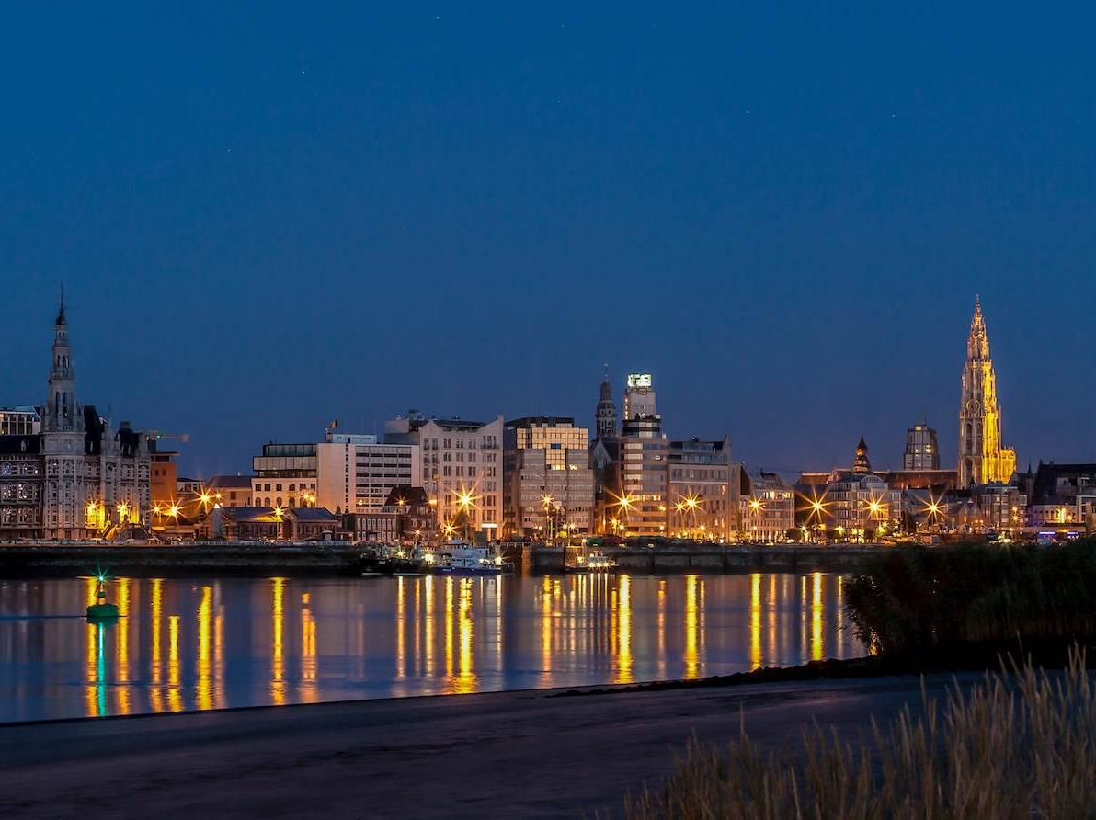
8 August 2019

Slide 2
Facts & Figures
20,000 students (16% from abroad, 116 nationalities)
1,247 PhD students
3,650 scientific publications each year
5,117 staff members (17% from abroad, 81 nationalities)
624 professors
290 assistants
2,933 researchers
1,270 administrative personnel
60,000 alumni

Slide 3
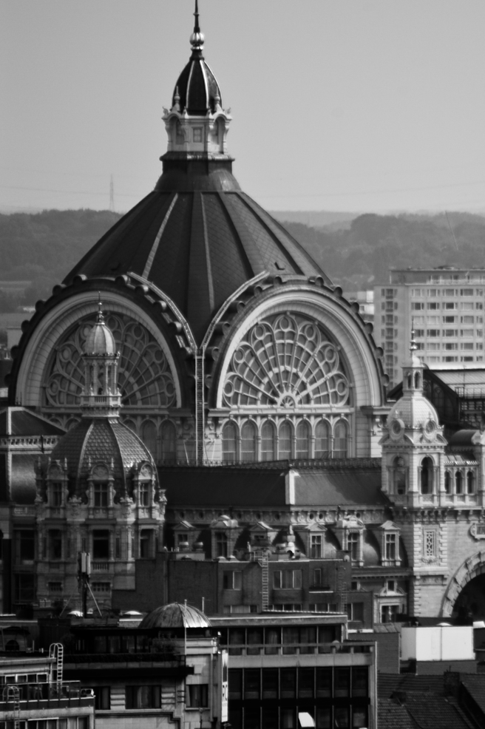
Facts & figures
5 campuses and 9 faculties
1 university hospital
17 institutes
140 research groups
144 programmes
30 Bachelor
69 Master (17 in English)
20 advanced Master (7 in English)
25 Postgraduates (2 in English)

Slide 4
Faculties
Applied Engineering
Arts
Business and Economics
Design Sciences
Law
Medicine and Health Sciences
Pharmaceutical, Biomedical and Veterinary Sciences
Political and Social Sciences
Science

Slide 5
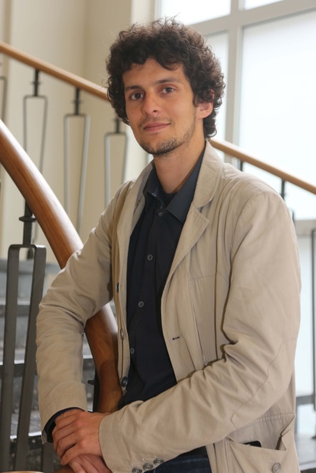
Tuition Fee
€900 to € 6000 per year
for most Master programmes
OCMW assistance = reduced tuition fee

Slide 6
Language
Bachelor programmes in Dutch
  Minimum B2 with ITNA test
  Secondary school certificate
Master programmes in Dutch and English
  Minimum B2 level
  Academic Bachelor degree in relevant field

Slide 7
Postgraduate of Dutch as a Foreign Language in an Academic Context
Full-time study
The objective is to prepare students for an academic career in Flanders.
After successful completion and evaluation the programme entitles students to a certificate. One of the final exams is the Interuniversitary Language Test for Dutch as a Foreign Languages (language test required by the universities of Antwerp, Ghent, Leuven en Brussels).
Programme fee: EUR 4270 for EEA students and EUR 5800 for non-EEA students (including all teaching materials)

Slide 8
Scholarships available
Young people (aged 17 to 25) planning to continue their studies: this means they have finished secondary school, achieved a qualification that allows them to enter higher education
OR
Adults planning to continue their studies: this means they have already attained a Bachelor or Master in their own country and would like to continue studying in Dutch-language higher education.

Slide 9
Conditions
Refugee status: asylum seeker / refugee status / subsidiary protection
Language proficiency: intermediate knowledge of English (CEFR level B1)
Bachelor or Master degree (excluding 17-25 year old adults with secondary school qualifications allowing them to study in higher education)
Ability to attend classes in a full time study programme
Plans to continue studying in Flemish higher education

Slide 10
Recognition of your foreign diploma
If you have a foreign diploma and want to study further at the University of Antwerp, you do not need to start a procedure at NARIC to apply for equivalence.
In Flanders, higher education institutions themselves are authorised to admit students.
Send documents to refugeestudents@uantwerp.be

Slide 11
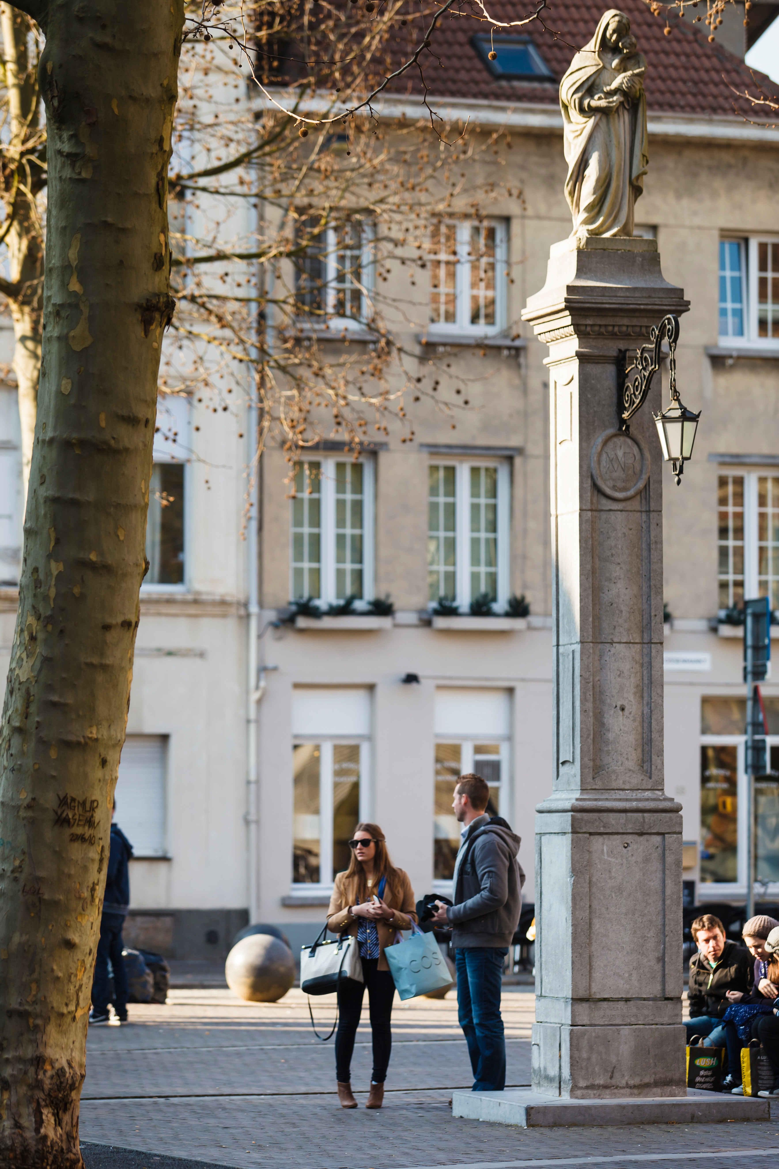
Applications
Apply online
Applications open 1 December
Applications for recognised refugee candidates close on 15 April
Start September

Slide 12
Try out our classes!
During the school holidays in November and February
A selection of classes and information sessions to discover the study programmes and to make your decision.
All sessions are conducted in Dutch.
Register online to receive the complete programme

Slide 13
THEA: A flexible programme for refugees with higher education prospects
THEA allows refugees to ‘try’ higher education during the final stages of their Dutch language studies.
The project is organised in cooperation with Atlas, the agency for civic integration of the City of Antwerp.
For more information contact Mrs Eveline Philippaerts from Atlas on eveline.philippaerts@stad.antwerpen.be or +32 (0) 3 338 70 16

Slide 14
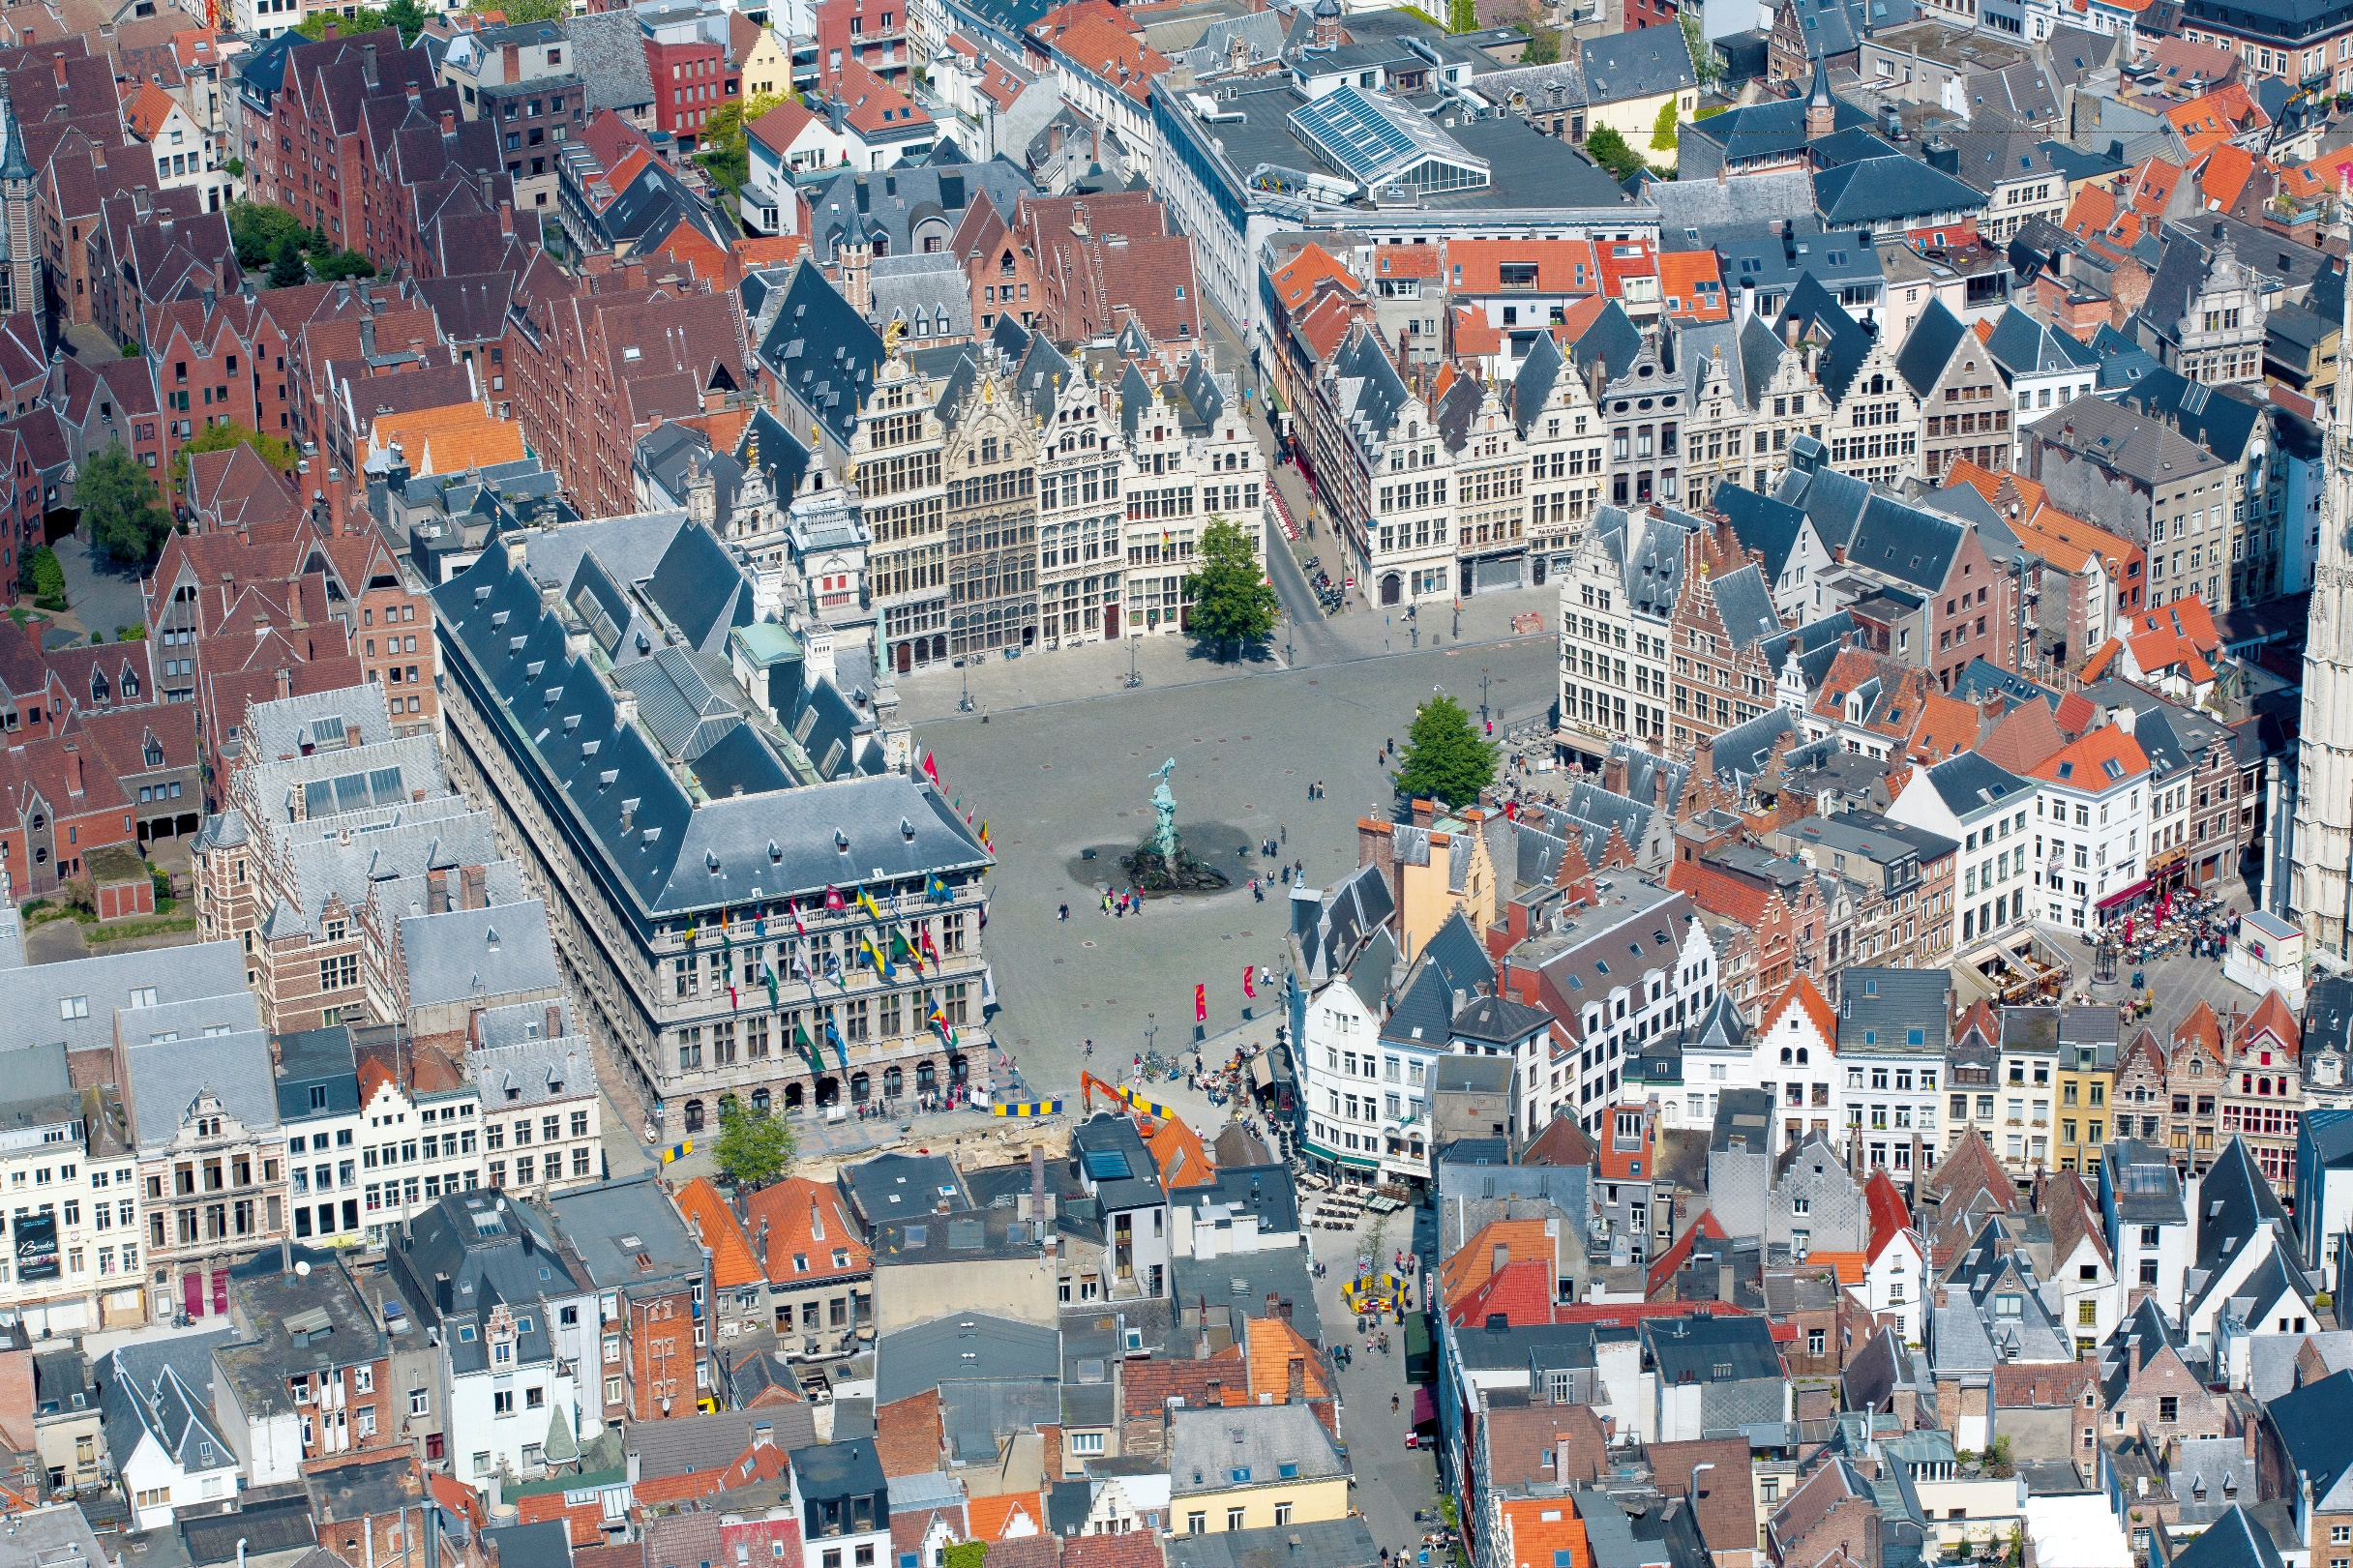
Contact:
refugeestudents@uantwerp.be

