Slide 1
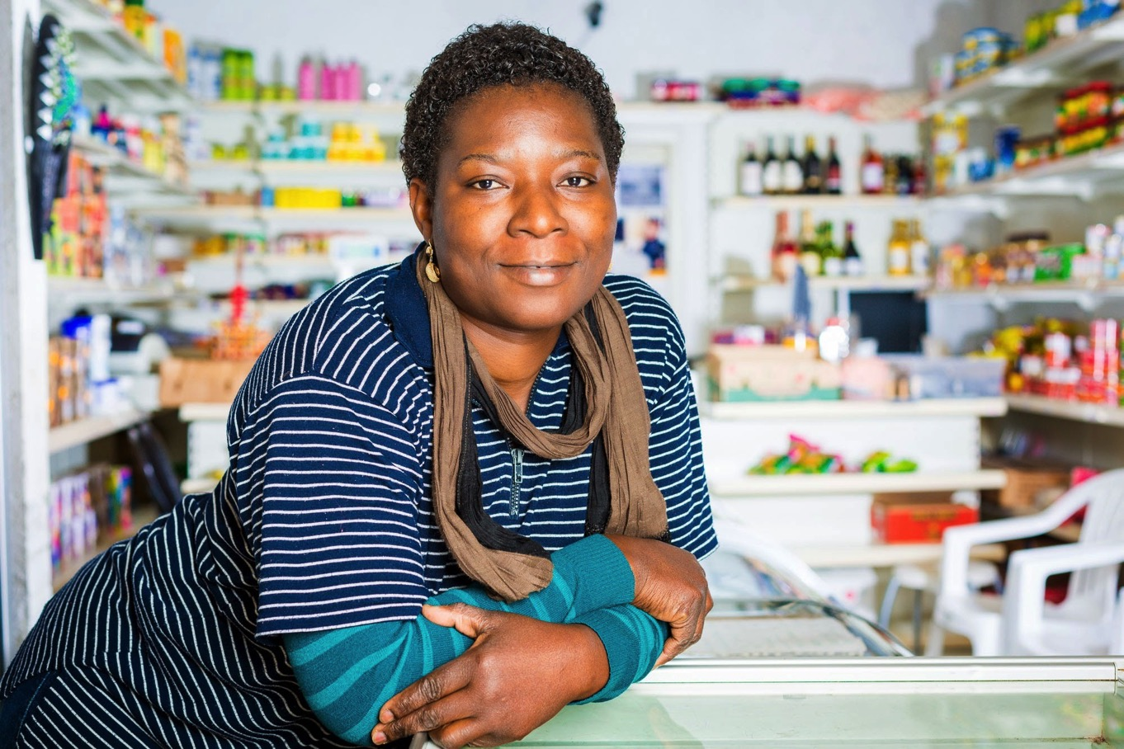
Promoting microcredit in Belgium

Slide 2
Outline
microStart – Vision, Mission & Values
Our Operations
Our Costumers
Our impact
Steps to start your business in Belgium

Slide 3
Vision, Mission & Values

Slide 4
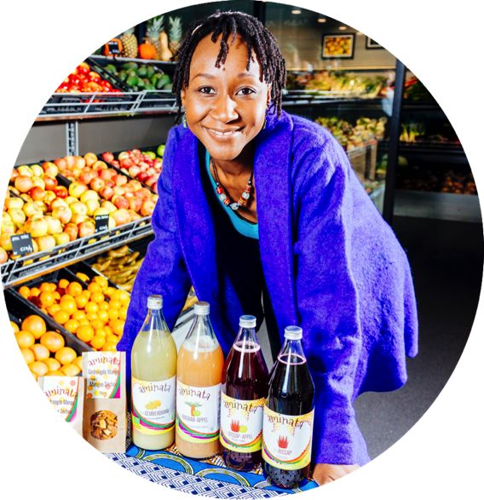
Vision
Each human being regardless his/her educational background, his/her income, his/her economic position or his/her geographical origin has a right to economic initiative and a right to choose his/her destiny in our society

Slide 5
Mission

Slide 6
Values
Innovation
Solidarity
Trust
Professionnalism
Respect

Slide 7
Our Operations

Slide 8
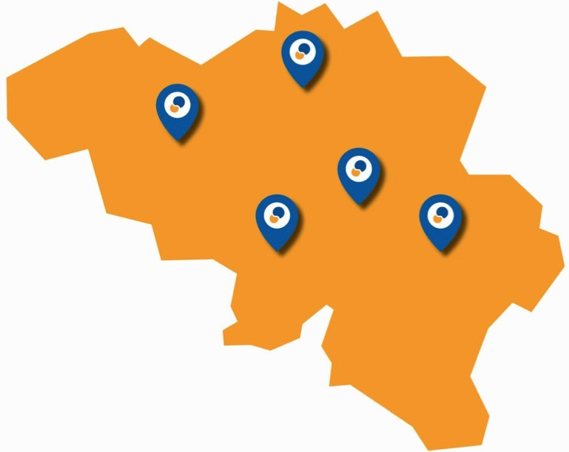
Offices & contact points

Slide 9
Our services
TEST CREDIT 2000€ / 12 months 100€ File costs 175,79€ Monthly installment | START CREDIT 7500 € / 36 months 375€ File costs 238,32€ Monthly installment | GROWTH CREDIT 15 000€ / 48 months 750€ File costs 372,92€ Monthly installment
Professional microloans from 500 – 15.000 €
48 installments maximum
Fees : 5% upfront
Individual rate : 8,95% - 9,95%
Individual or group lending
Investment – cash
Option « Liberté » - 0% interest rate
Garantor

Slide 10
Our process
Recep tion
Instruction
Credit comittee
Disbursment
Follow up
Contact
Renewal
Through Prospection or Partner
With or without appointment
Creation of the credit file with the client
Weekly
Min. 6 months
Identification of client’s needs
Information on microstart
Business development Services before start-up
Business development Services after start-up
Individual
Group
Individual
Group

Slide 11
Business Development Services
Up Front Services
Training to prepare the business management exam
Individual help to build a Business Plan
E-Learning
Post creation Services
Coaching & Mentoring
Expert Meetings

Slide 12
Our Customers

Slide 13
Professional Occupation

Slide 14
Focus on the underserved
80% below poverty line

Slide 15
Focus on the underserved
62% born abroad

Slide 16
Education
33% have higher education degree
54% have reached level of secondary school
12% can read and write
1% cannot read and write.

Slide 17
Our Impact

Slide 18
Impact study 2017
Sustainibility rate of the starters = 75% after 2.5 years of activity
Each microentrepreneur create 1.6 jobs
1€ invested in microStart brings back 4€ to the collectivity thanks to a reduction of social allowances (unemployement benefits) and an increase of taxes et social contributions.
Source: Vlerick – KPMG – projet VISE

Slide 19
Advocacy
Success !
Possibility to keep your unemployment benefits during 12 months since october 2016
What is still a problem ?
Management Exam to get a VAT number
Few flexibility in social contributions payments for little businesses
Microcredit regulation

Slide 20
Planning to start your business in Belgium ?

Slide 21
Obstacles to overcome
Being self-employed in Belgium needs :
Over 18 years old
Acquire management skills
Belgian citizenship or part of the EEA

Slide 22
Obstacles to overcome
Access to management is mandatory and is acquired by :
Having a management degree
3 years experience in management
Passing the management test of the central jury
Through another person :
A third- degree relative
The spouse or legal cohabitant
Has been cohabiting for more than 6 months

Slide 23
Obstacles to overcome
Access to profession
There are 34 regulated professions, divided into 3 categories
Automotive industry (add examples)
Construction and related activities (add examples)
Care industry (add examples)
Liberal professions also require access to profession (add examples)

Slide 24
Obstacles to overcome
If you don’t have the Belgian citizenship
You need a working permit / professional card
They are specific to each region and cost 140 €
You have to reside in Belgium legally
Tip : Ask your business counter, they will assist you throughout the process !

Slide 25
Steps to follow
Step 1 : Get prepared
Management skills certificate
Access to profession
Authorizations and licences
Business plan
Tip : Ask one of microStart’s volunteers, they will be happy to help or feel free to have a look at our e-learning platform on our website !

Slide 26
Steps to follow
Step 2 : Find fundings
Personal funds
Family/Friends/Associates funds
Banks
Microfinance institutions

Slide 27
Steps to follow
Step 3 : Create your company
Find a trustful accountant
Choose a convenient legal form
Get your company number
Activate your VAT number
Tip : To complete this step, go to a business counter (PARTENA, Securex, UCM)

Slide 28
Steps to follow
Step 4 : Put things in order
Pay your social contributions
Affilitate to a mutuality

Slide 29
Steps to follow
Step 5 : Get insured
Compulsory insurances (health insurance)
Complementary insurances

Slide 30
Steps to follow
Tip : Since the October 1st, 2016 , it is possible to combine unemployment benefits and additional activities as a self-employed person more easily for a period of 12 months. Ask your counselor about ”la Mesure Tremplin”.
Tip : Smart / JobYourself / Dies allow you to practice your economic activity while keeping the status of unemployed / employee → Coopérative d’activités !

Slide 31
Good to know !
Having a good and trustful accountant is of prime importance !

Slide 32
Contact us !
Hicham EL BEKKALI – Community Officer
Tel : 0493 27 35 34
Email : hicham.elbekkali@microstart.be

Slide 33
Thank You for your attention

