Slide 2
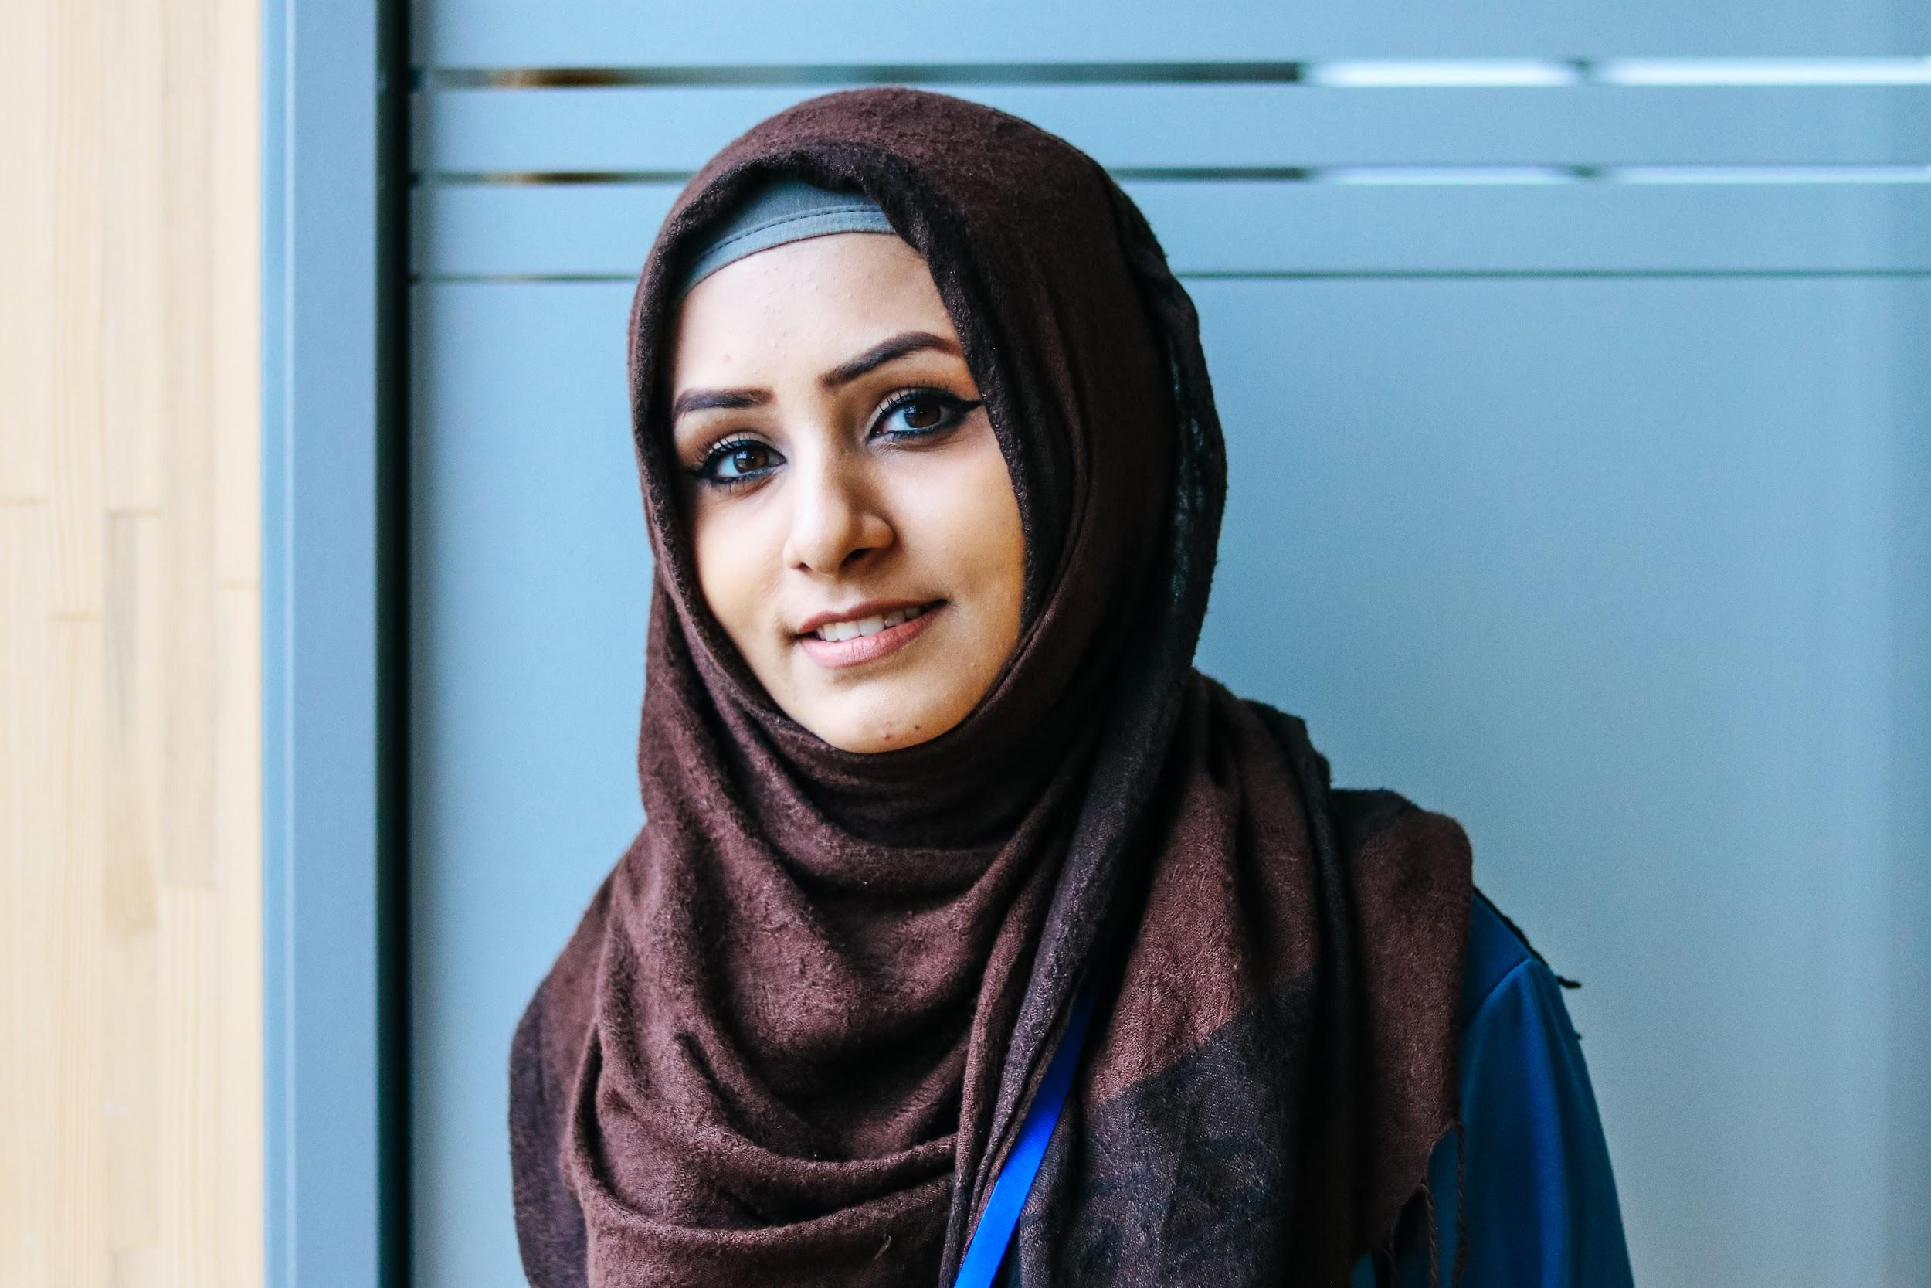
In a world of conflict and upheaval, we as an international community are missing out one of the best investments there is: the education of young people.
Education will prepare youth for the world of tomorrow and will make the world more resilient, sustainable and peaceful.
Notes:
Education is a priority need in displacement. For too long we were not aware enough of education’s life-sustaining and protective role during conflict and crisis, and misjudged the social and economic consequences of the lack of education during displacement for both host and home countries.

Slide 3
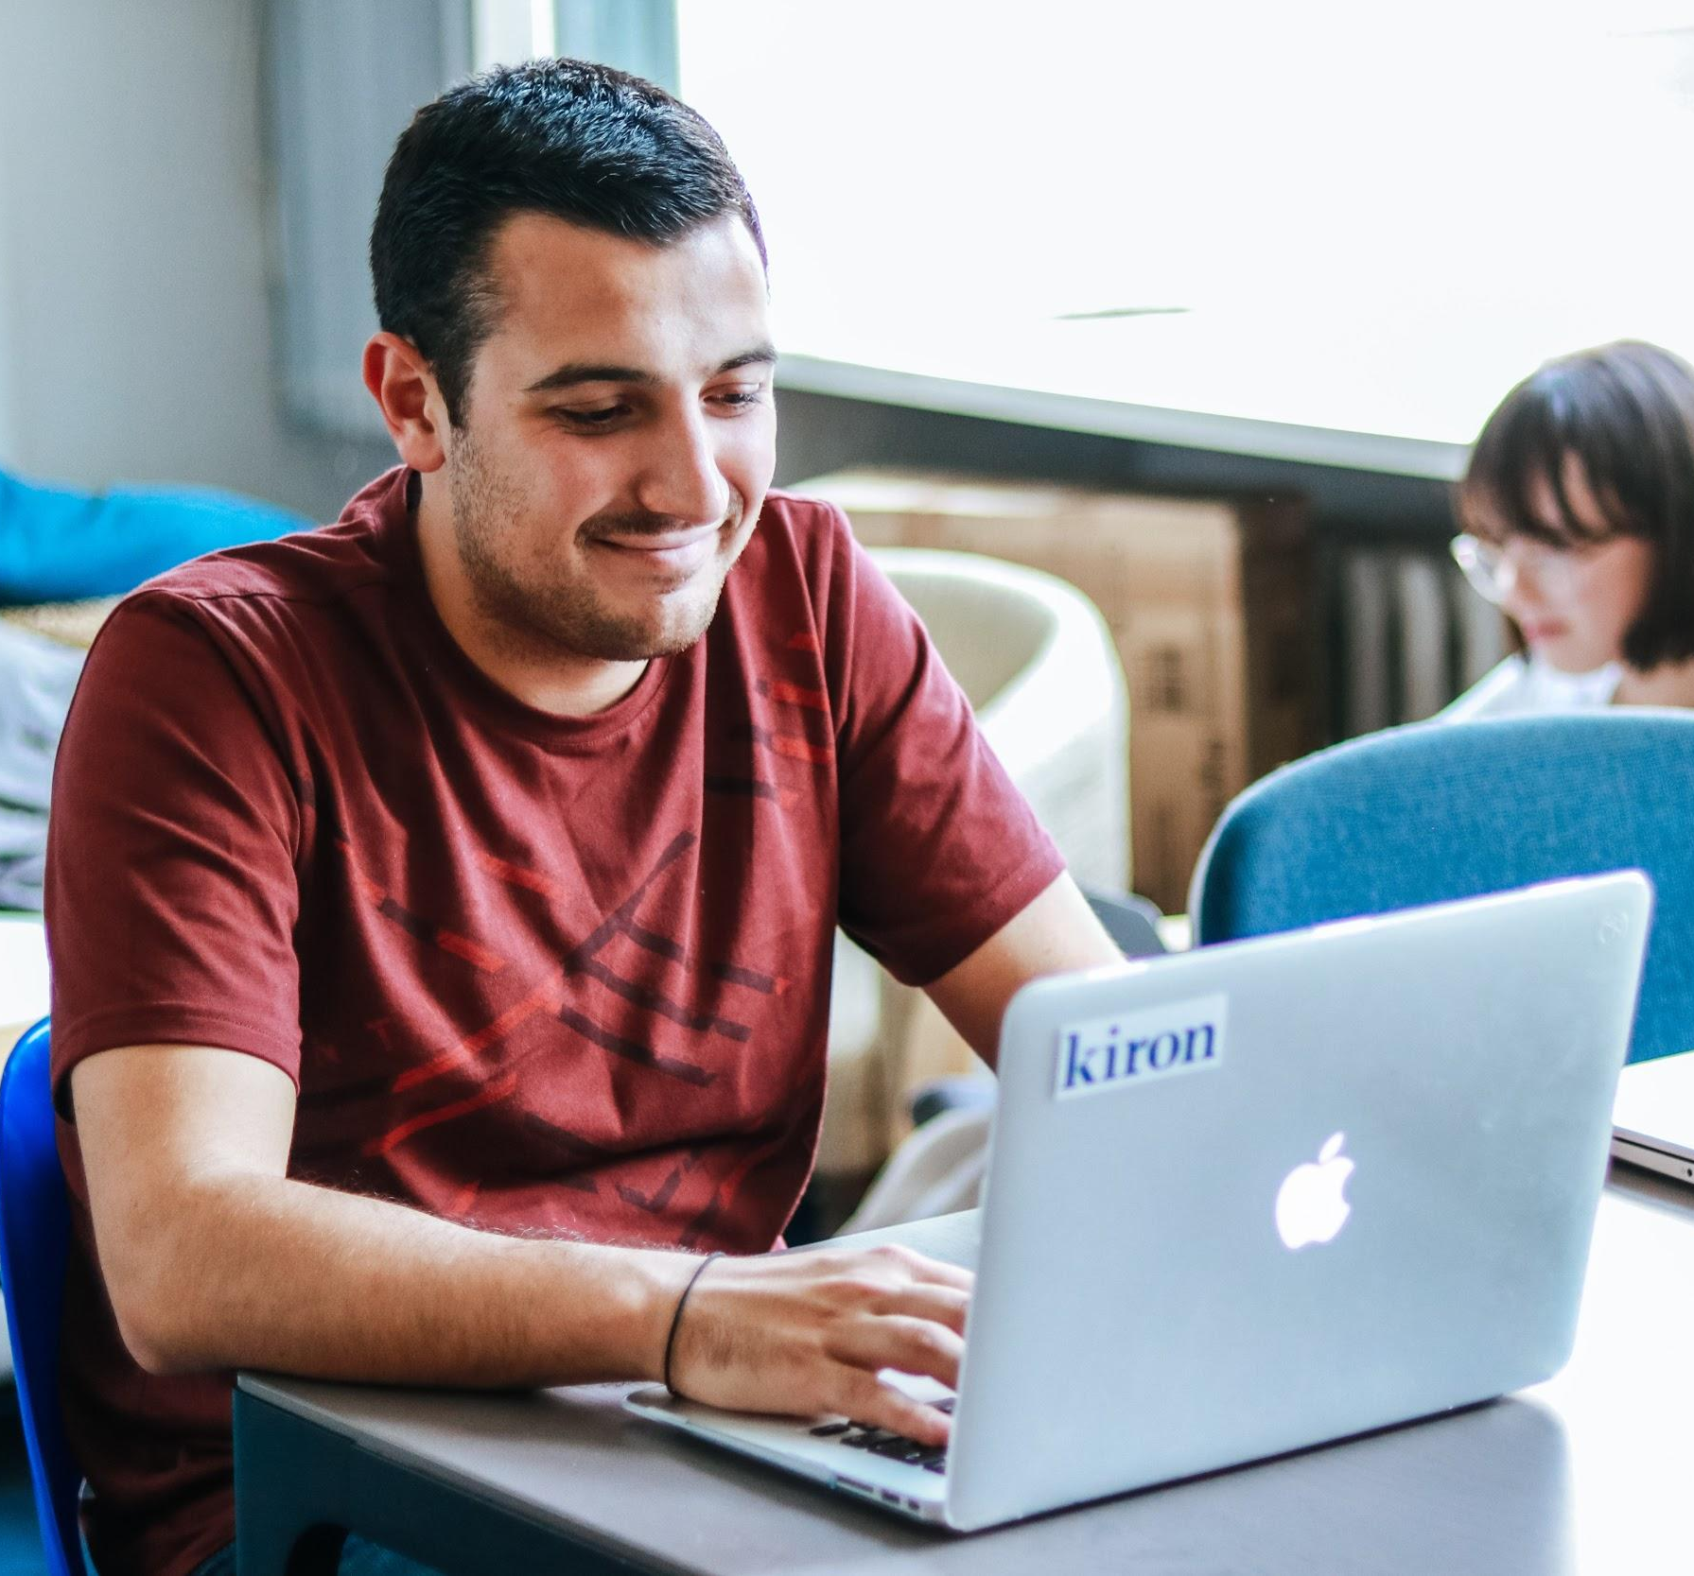
Our mission
- we want to provide digital learning opportunities for academic, professional, and personal growth.
Our vision
- is a world in which everyone has an equal chance to access and succeed in higher education.
Notes:
SDG4: Ensuring equitable quality education for all.

Slide 4
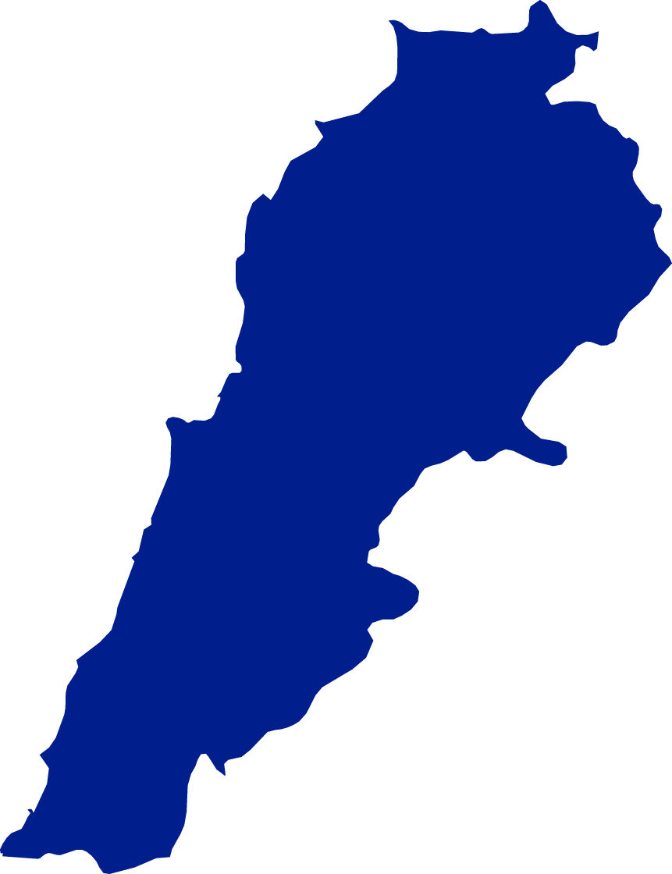
Kiron is a non-profit organisation addressing a global challenge
through scalable technology
Founded in
61
partner universities with
2015
cooperation agreements across
Currently counting
80
8
different countries
employees and
4
3
countries
6500+
offices in
students
GERMANY
LEBANON
JORDAN
Status: July 2019

Slide 5
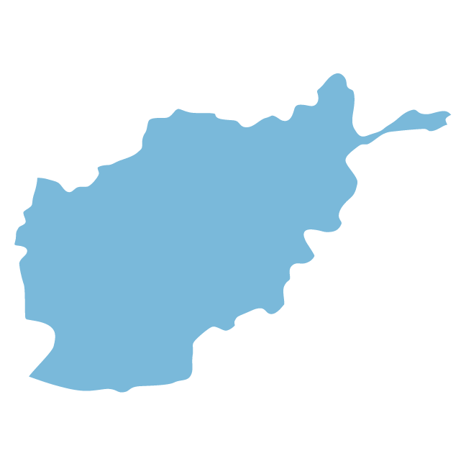
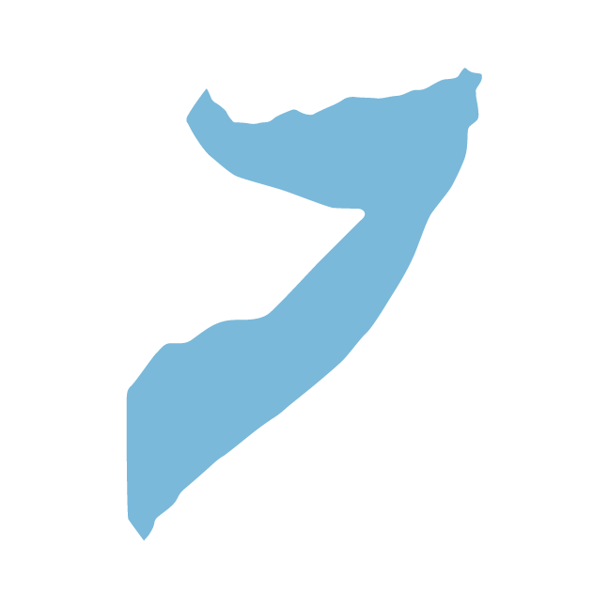
The Kiron community is around the world
Most common countries of origin:
6500+
STUDENTS
49%
7%
Syria
Afghanistan
4%
40%
Somalia
75+ Countries
22%
78%
11%
24%
31%
28%
6%
Female
Male
<20
21-25
26-30
31-40
41<

Slide 6
Our solution

Slide 7
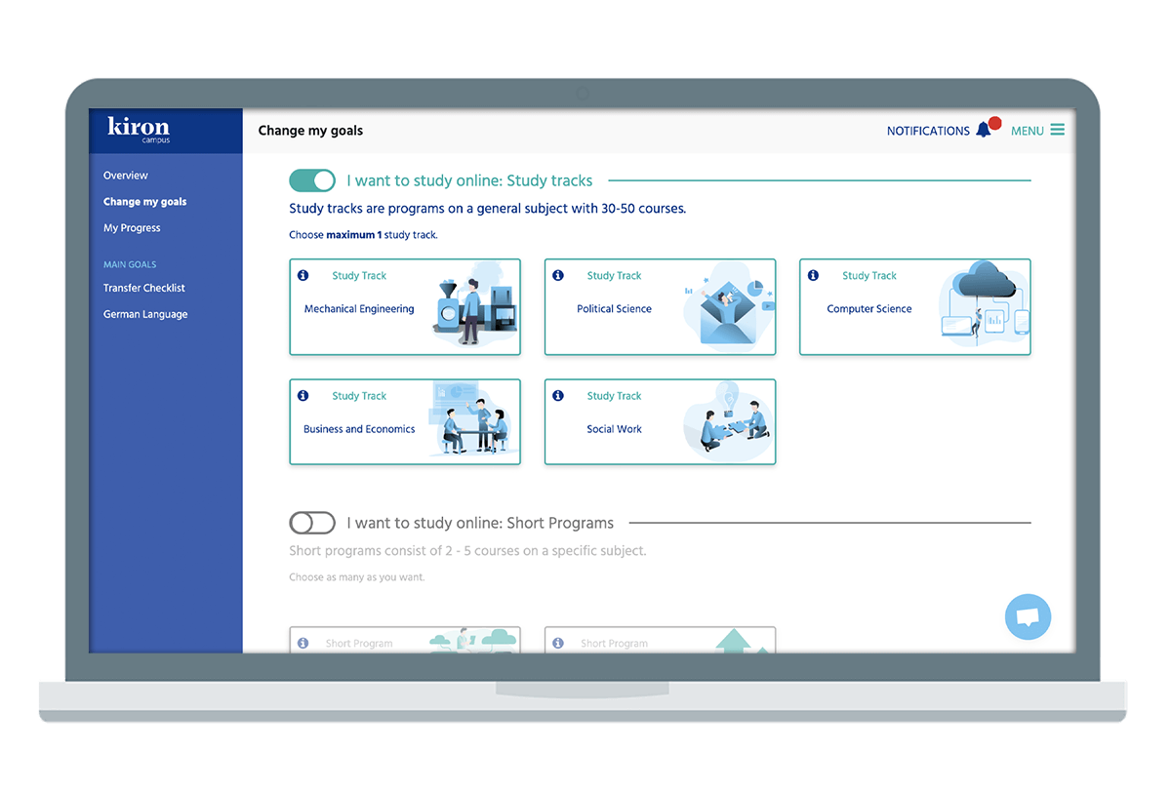
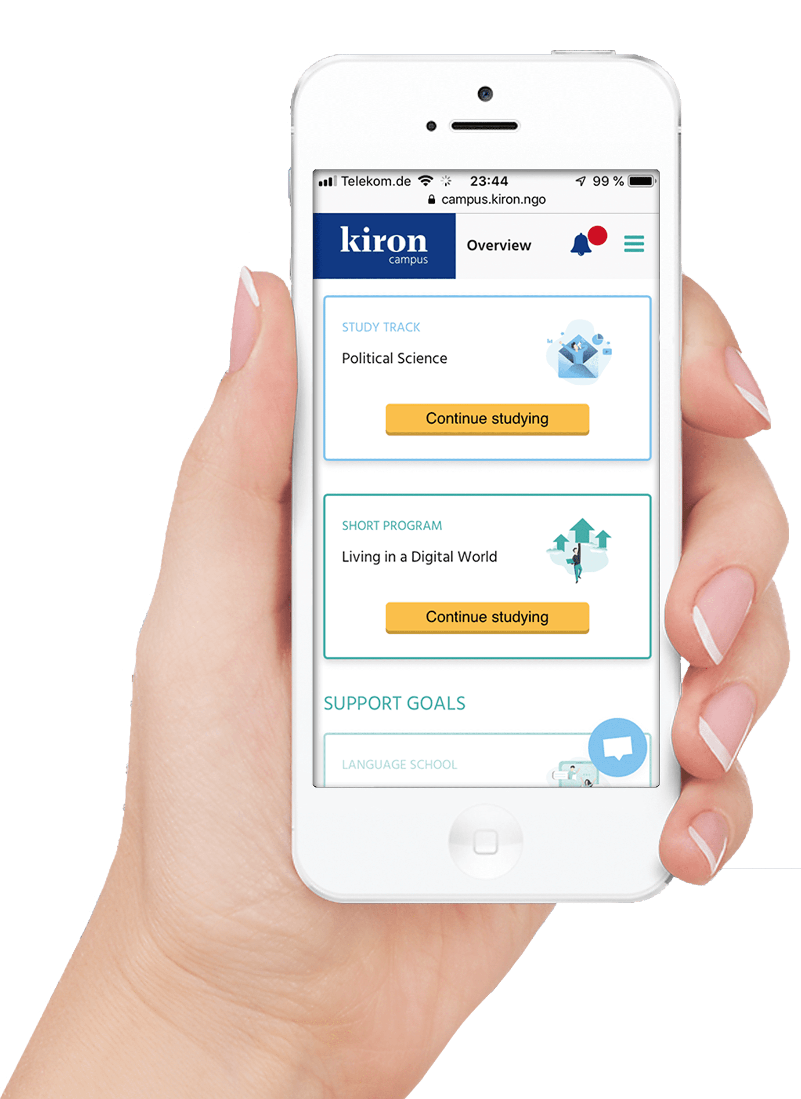
With Kiron, students have free access to digital learning

Slide 8
We offer a variety of programs for personal, professional and academic development
1
2
3
University preparation
Job market preparation
Personal growth
– “Skill Booster Programs”
in various fields (e.g. Start your own online business)
– employability skills (e.g. Learn programming with Python)
– online transfer guidance
tool
– five different study tracks (e.g. Social work and Mechanical engineering)
– language programs (e.g. English and German)
– student community

Slide 9
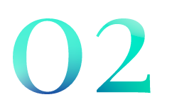
What makes us unique
Our platform is accessible globally - students can learn in refugee camps, libraries, cafes or on their phone. Anytime and anywhere for free.
We are a community. Our students learn together in digital classrooms, study groups, and our own Kiron Forum.
Our preparation, language, content and digital literacy classes help our students get ready to live and work in a digital world.
We are experts in global digital education and deliver adapted solutions on the ground in Europe and the MENA region.
Our global network of partners allows us to provide flexible, agile solutions to the world’s most pressing challenges.

Slide 10
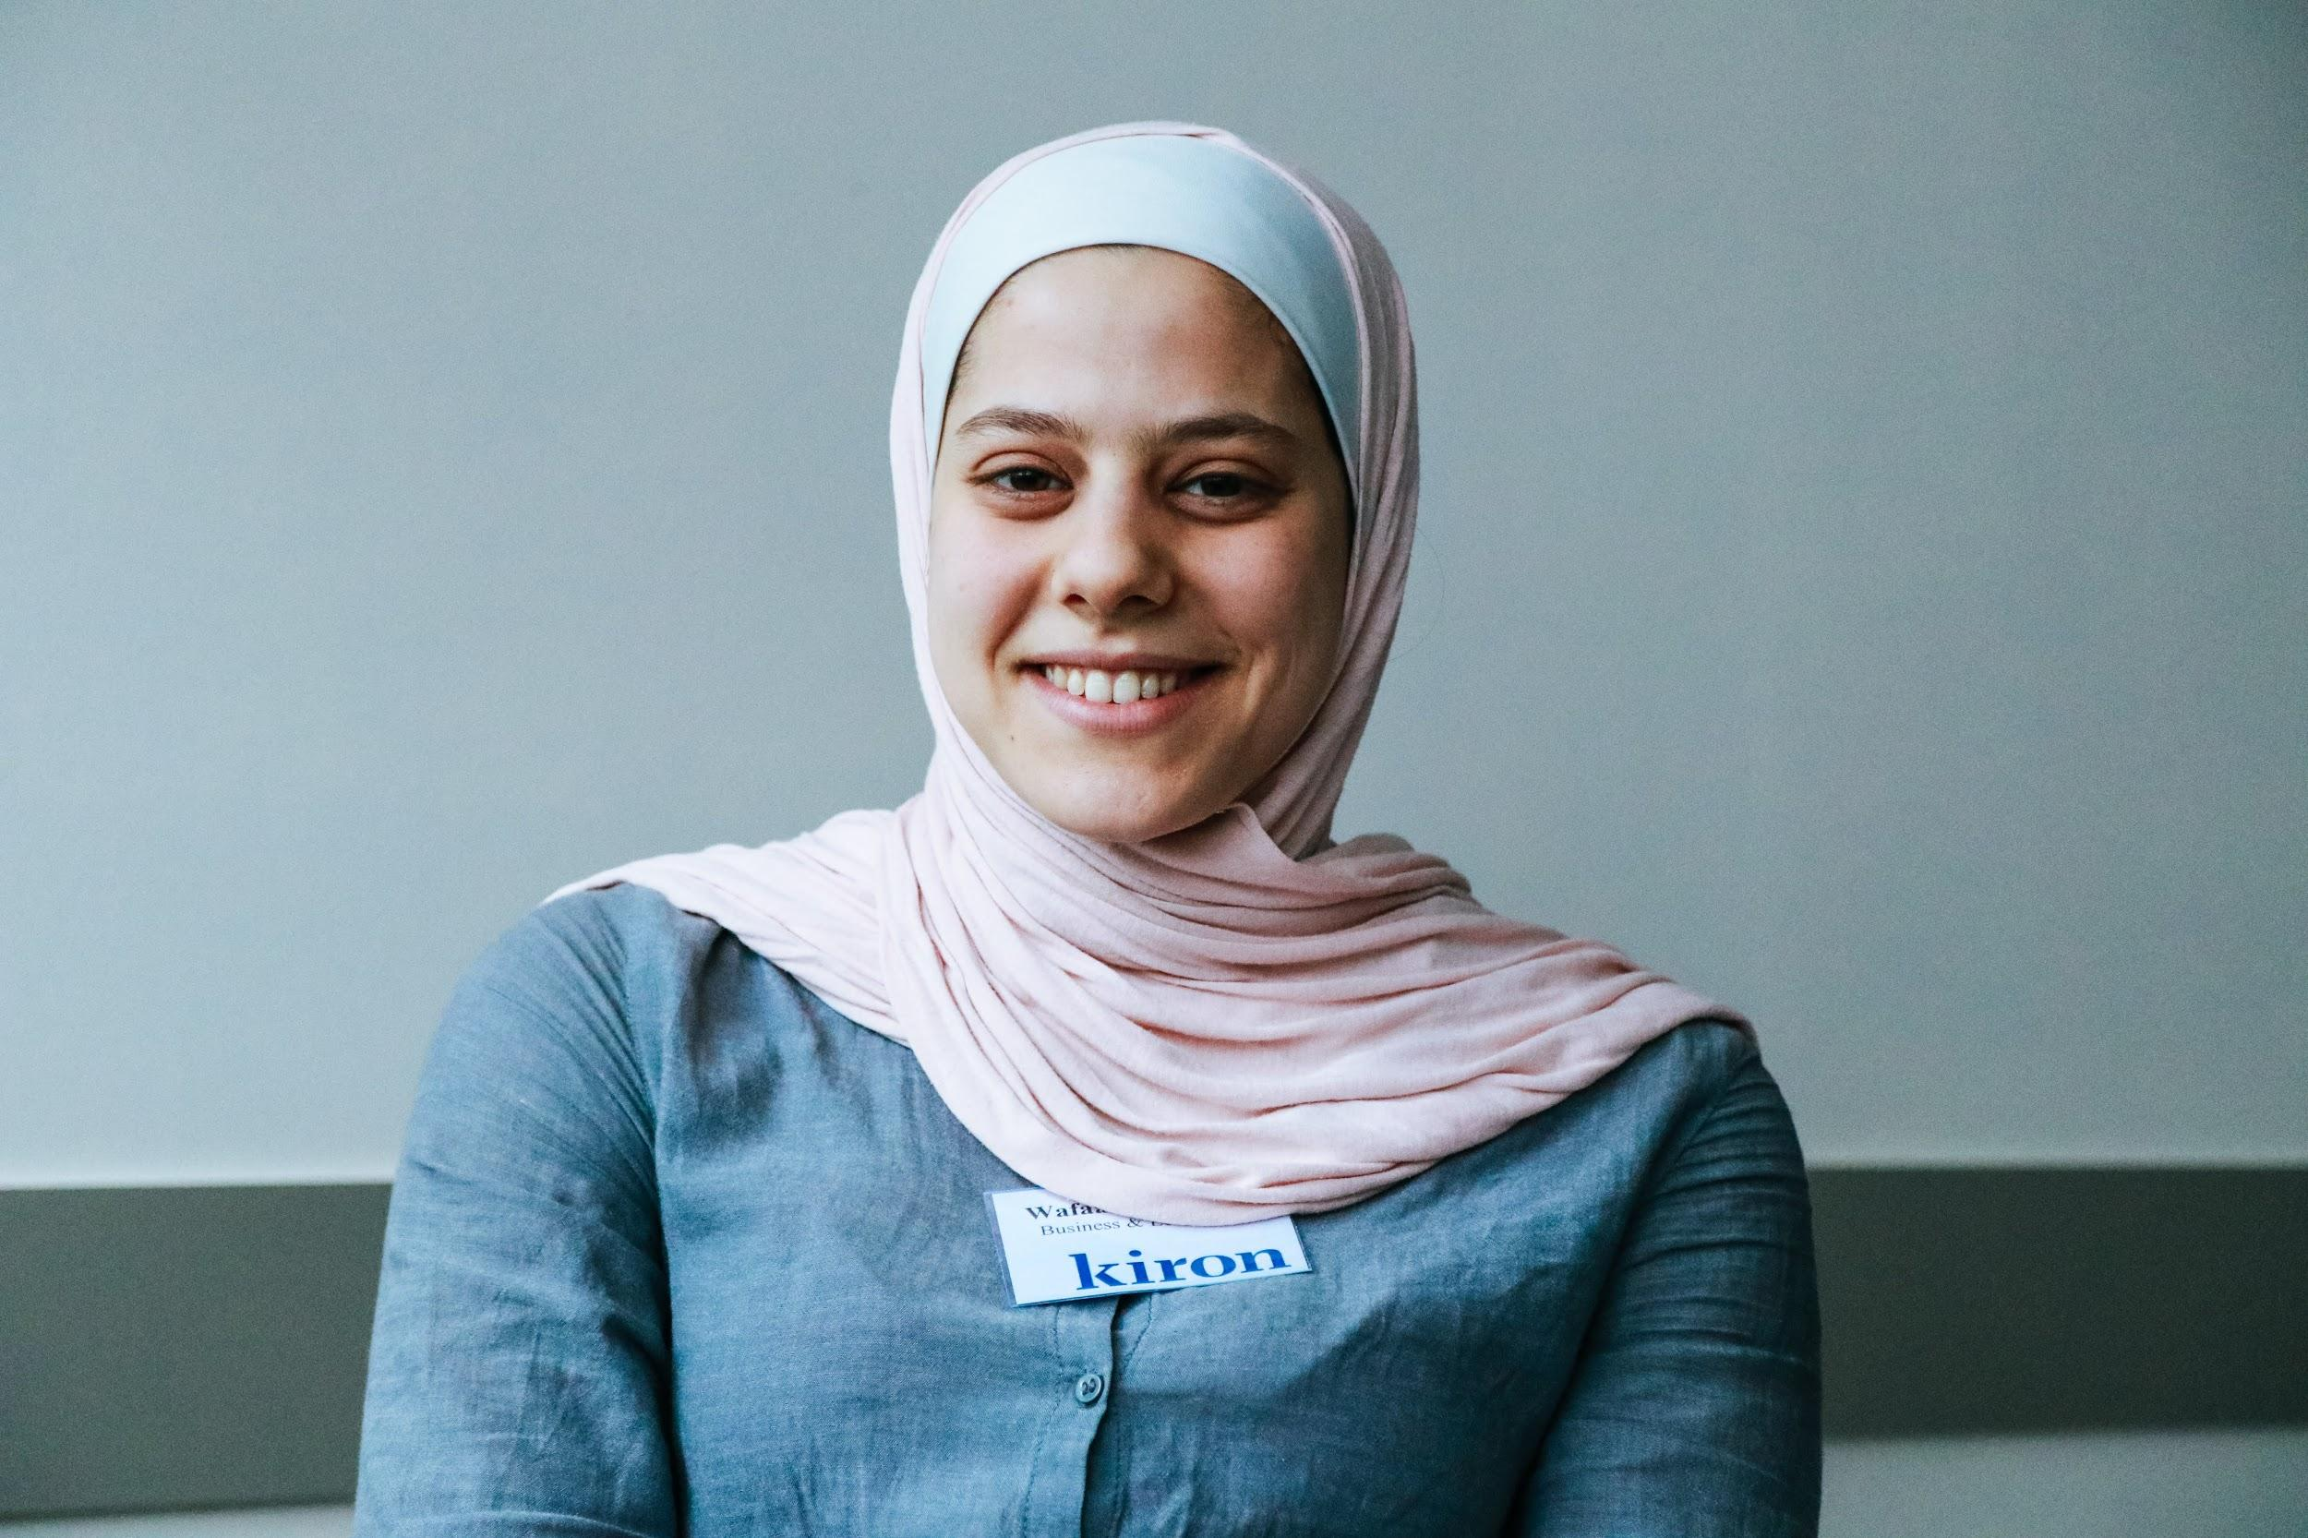
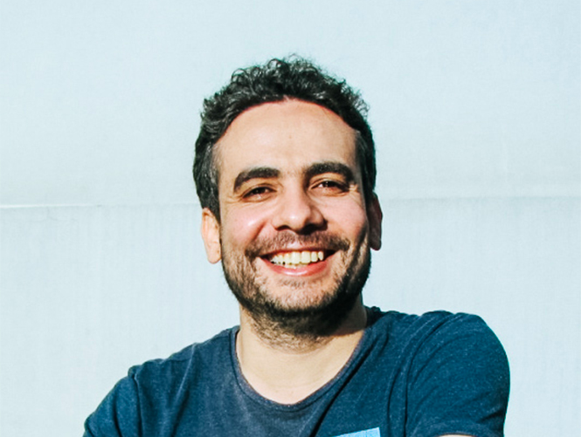
Wissam
Wafaa
Wissam studies business and economics in Lebanon. During his studies at Kiron, he completed several courses with a focus on marketing. Wissam is also an artist and has had several exhibitions in the past. His goal is to transfer to a university and start an art company. Through the courses he took at Kiron, he learned skills to work on his business plan.
Meet our students
“
Kiron has helped me to connect and build bridges, transfer to a university and follow my dreams.
I want to open a business of my own, maybe using my paintings, and I feel that the courses that I take give me a better idea of how I want to run things in the future.
“
Originally from Damascus, Wafaa has become a role model for other Kiron students. Wafaa studied Business and Economics at Kiron and is now a fully matriculated student at the University Duisburg-Essen. Her studies at Kiron, participation in several support services and additional language courses, enabled her to transfer to a university.
”

Slide 11
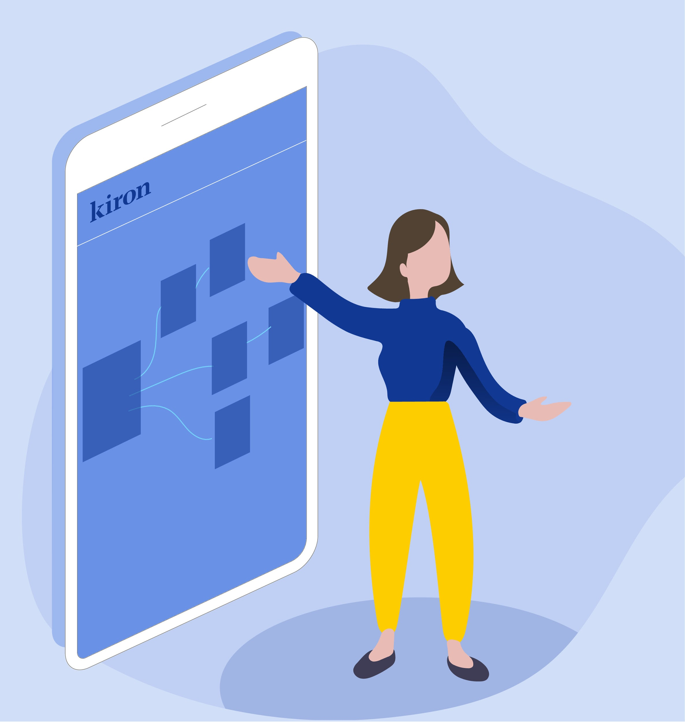
Join today! Become part of our student community at:
https://campus.kiron.ngo/
Find out more on: https://kiron.ngo/

