Slide 2
Choose a training

Slide 3
Program :
Inform the public about professions and training opportunities

Slide 4
My professional goal
My goal for today
1
What profession do I want to practice?
2
How to achieve it?
3
How to choose the right training?
5
My action plan?
4
What questions to ask before starting a training?

Slide 5
1.
What profession
do I want to
practice ?

Slide 6
Information about professions: www.citedesmetiers.brussels/fr-BE/Chercher/
Several approaches to find a profession
that suits you best
Notes:
Possibilité de visionner les vidéos métiers sur les tablettes ou sur les ordinateurs
Possibilité de découvrir les métiers via les zoom métiers + découverte métiers BF

Slide 7
2.
How to achieve it?

Slide 8
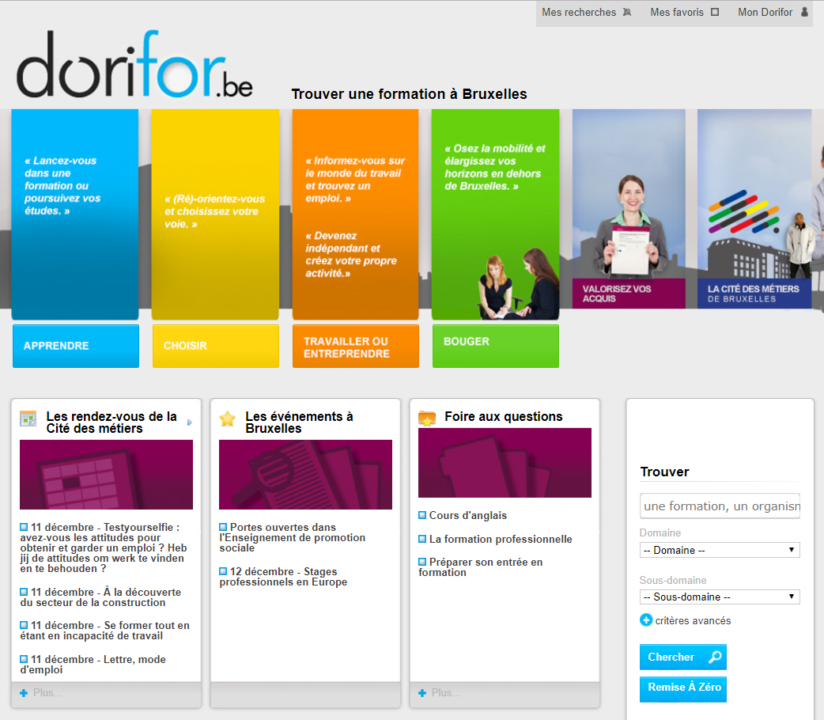
Information on trainings: www.dorifor.be
Create an account to get all the notifications
If you have experience
FAQ
Calendar workshops and infosessions
Search by training name
Search by field of activity
Notes:
Basculer sur le site web Dorifor

Slide 9
3.
How to choose
the right
training?

Slide 10
Dual training
Vocational training for job seekers
(training contract)
Centres de référence professionnelle
Formation PME
Cefa
Bruxelles Formation
OISP
Online training
Bruxelles Formation : Espace numériques
Fédération Wallonie Bruxelles : e-learning
Actiris : Brulingua
Etc.
Fonds sectoriels
Enseignement de Promotion sociale
Enseignement supérieur
de plein
exercice
Higher Education
Notes:
Nous ne parlerons pas de la formation privée et de l’associatif non qualifiant de type «éducation permanente».
À noter : possibilité de se former dans une autre région si on ne trouve pas ce qu’on cherche à Bruxelles.

Slide 11
Some criteria that can help me make my choice :
Admission conditions (with or without diploma) + possibility of exemptions through La Validation des compétences (skills validation)
Curricula and types of learning (on site, workshop on the field, internship, …)
Certifications (professional training certificate, certificate of skills acquierd in training, qualification certificate recognized by the Wallonia-Brussels Federation, …)
Pratical organization : different schedules, training dates, duration, prices (sometimes free)

Slide 12
4.
What questions to ask
before starting a
training?

Slide 13
What is my training need ?
French or Dutch lessons
Professions discovery
Literacy
Basic training
Targeted
job
Pre-training
Vocational training
Skills training
The various vocational training « operations » :
A path
to employment

Slide 14
What if it’s pratice that I need ?
Stage de fin de formation
At the end of training (optional)
Stage d’observation
Before or during the training to get a more precise idea of ​​the profession
Max 4 weeks
FPI en entreprise
Have the minimum level B1 and the skills in the function / sector targeted
First (ex-stage de transition). Actiris
Max 6 weeks
Stage d’immersion linguistique en entreprise
Under 30 and max CESS, registered with Actiris as "job seeker" after studies (domiciled in RBC)
Internship in a French, Dutch or English environment
6 to 8 weeks
Principle: train a future employee in the company.
3 to 6 months
1 month to 6 months + commitment for an equivalent duration
Convention d’immersion professionnelle
Internship agreement (Employer – Intern)
1 to 6 months

Slide 15
5.
My action plan?

Slide 16
Pathway to training
Training
Selection interview
Tests
Information
session
Find out

Slide 17
Skills Profile Tool for Third Country Nationals https://ec.europa.eu/migrantskills/#/

Slide 18
How do I keep informed?
www.dorifor.be
www.citedesmetiers.brussels
www.bruxelles-j.be
Call center 0800.555.66

Slide 19
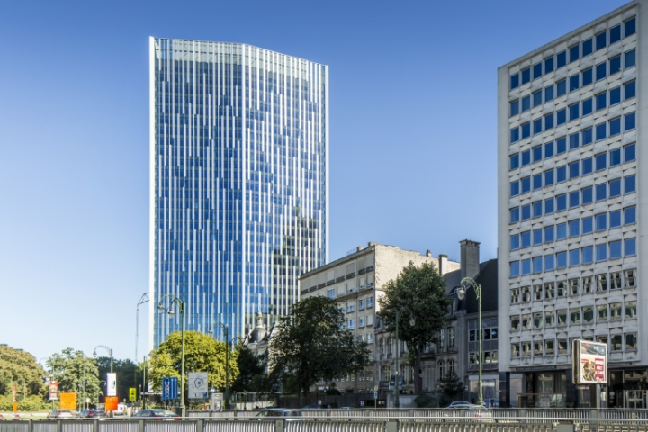
Welcome to the Cité des métiers !
On site information
A welcoming space providing quality support and advice
Anonymity of services that focus on individual needs
Neutral information, which is intended to be clear and factual
Open to all
Free access

Slide 20
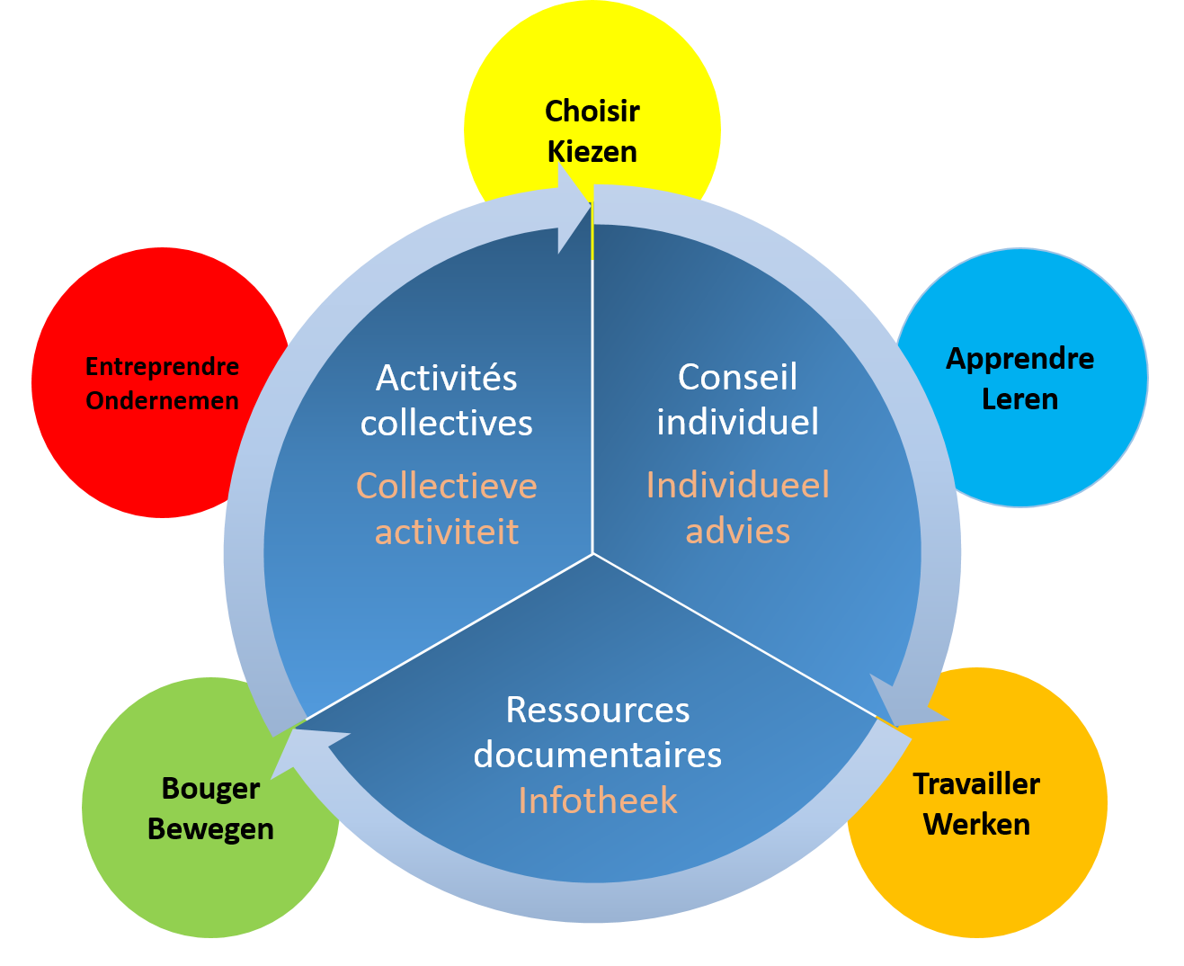
Advice and resources in one unique location
Five themes
Three types of activity

Slide 21
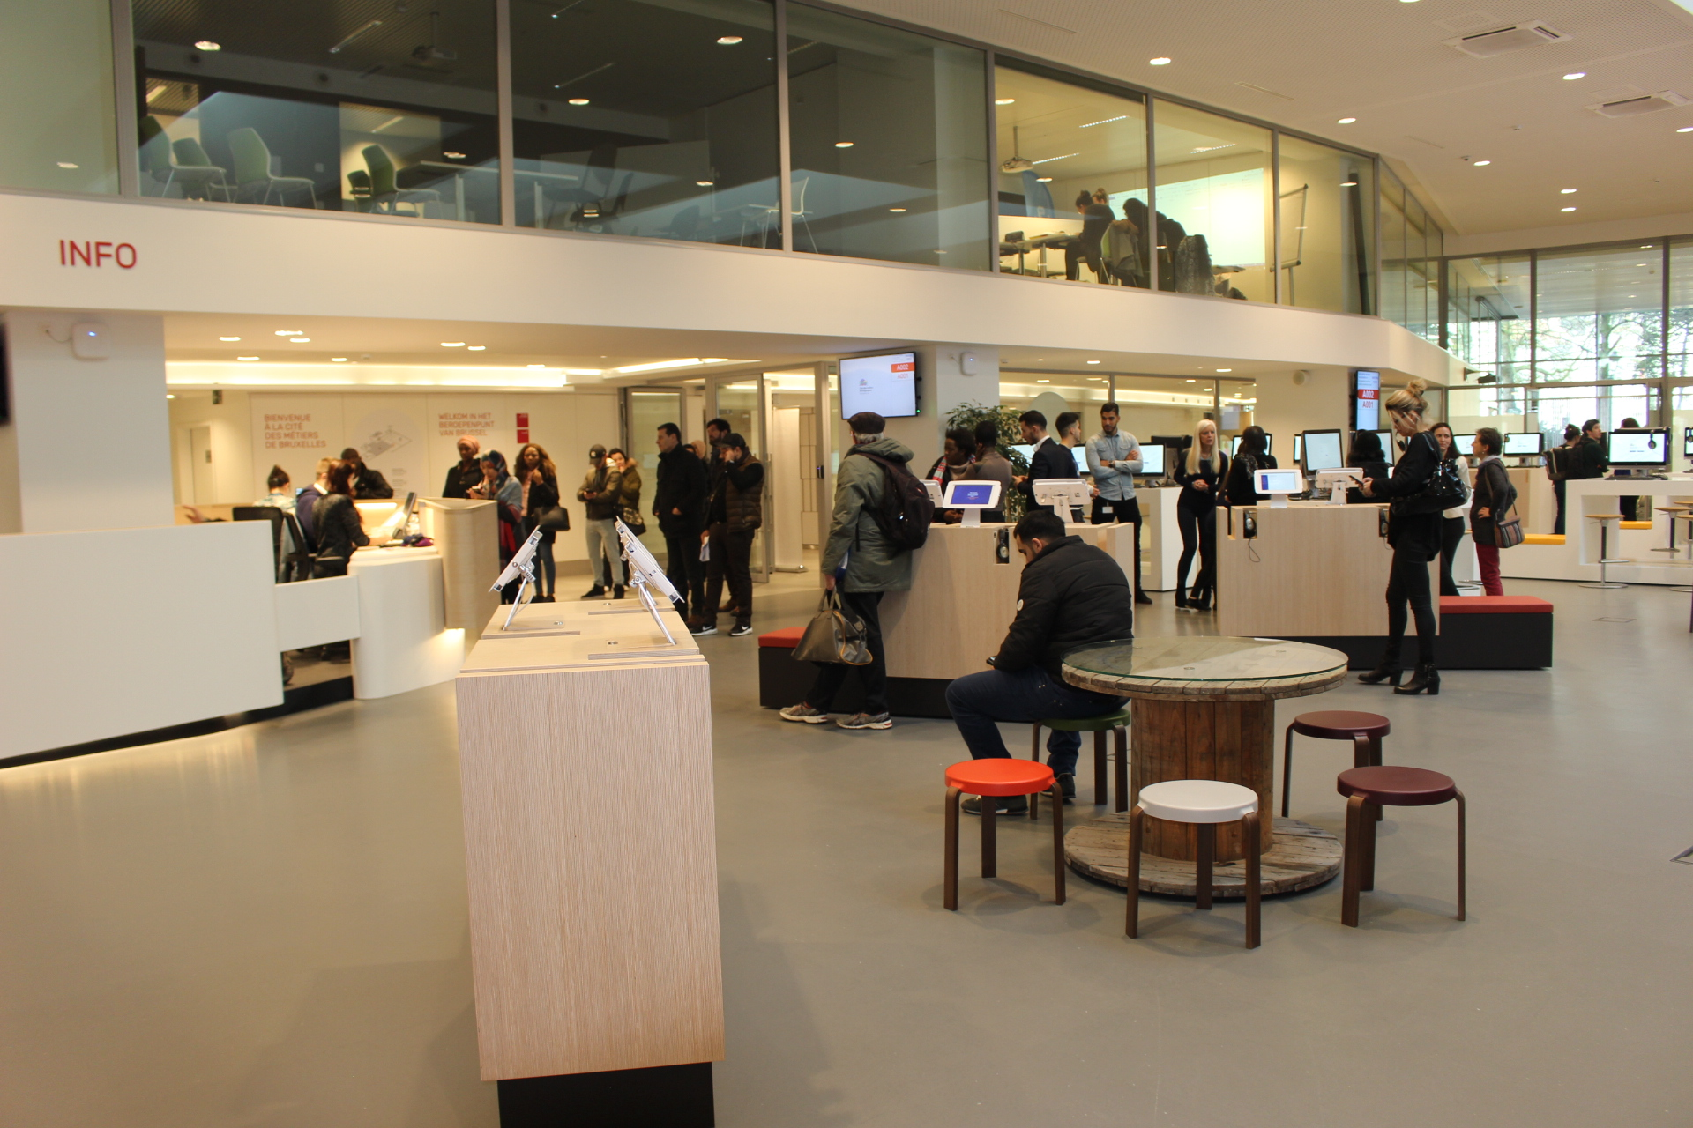
Advice and resources in one unique location
A welcoming space

Slide 22
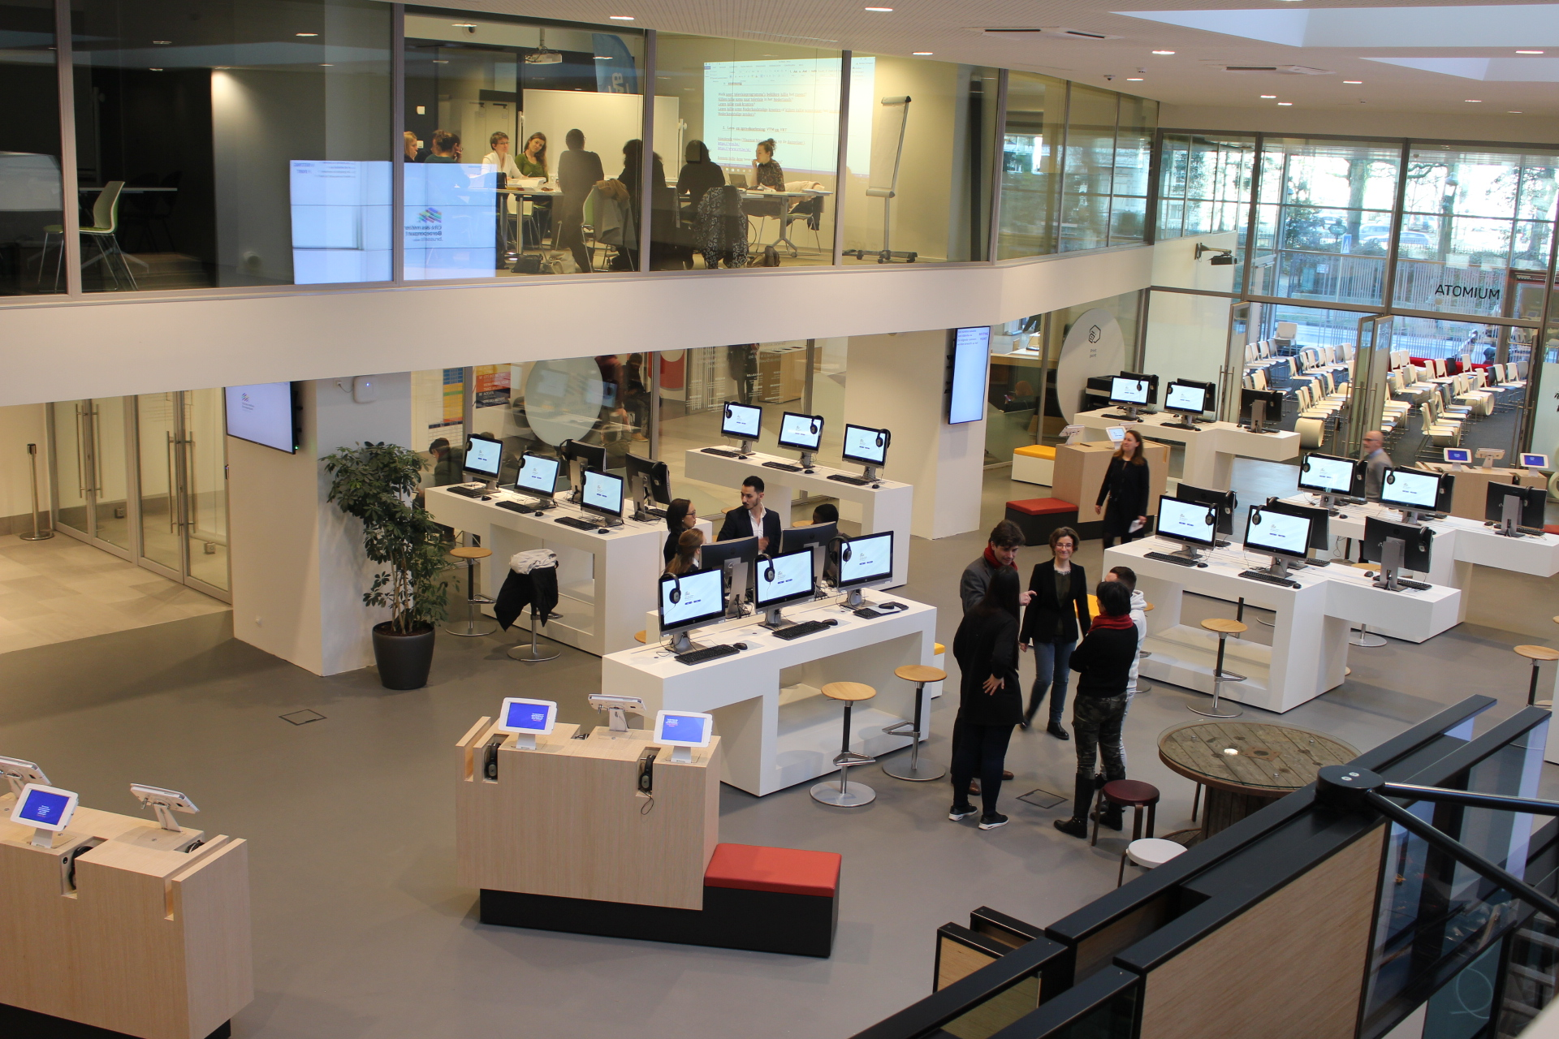
Advice and resources in one unique location
Free access to an autonomous research space

Slide 23
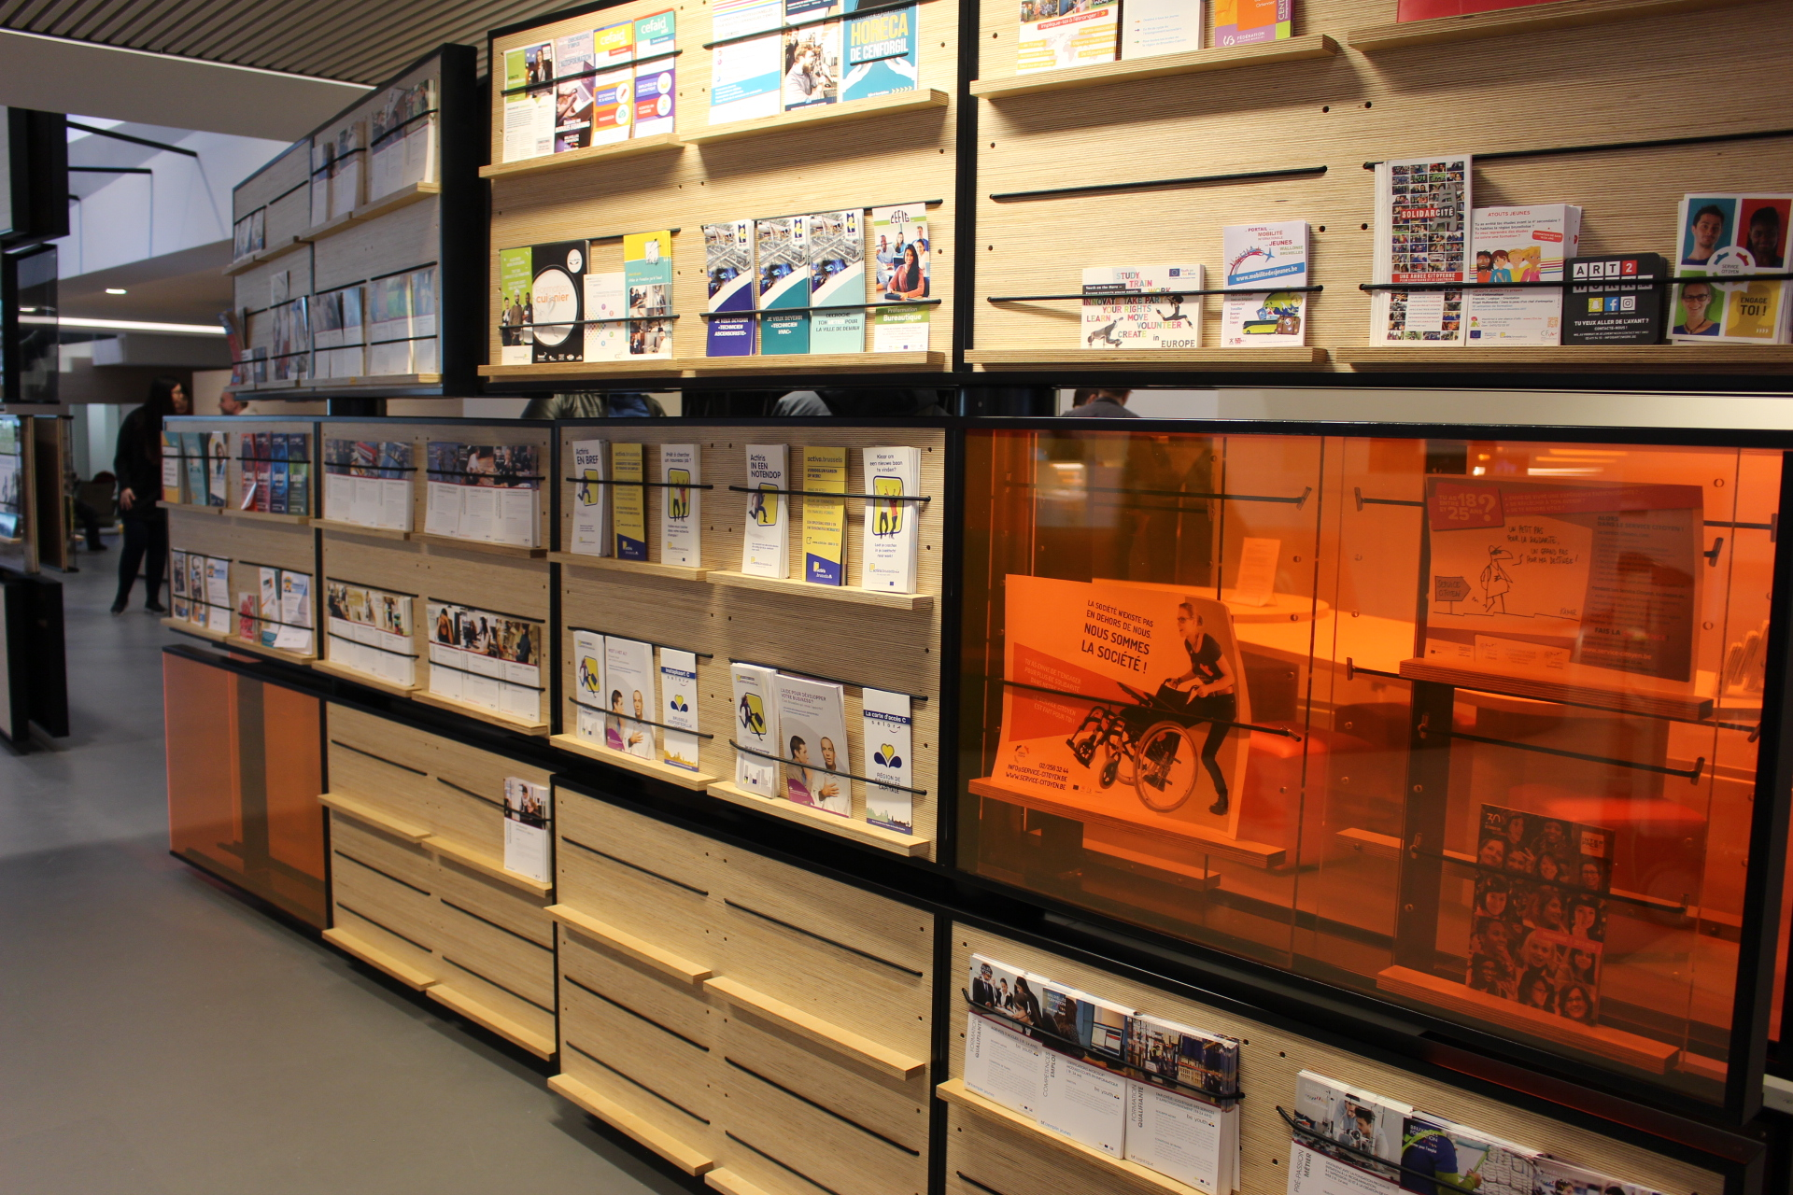
Advice and resources in one unique location
The careers wall

Slide 24
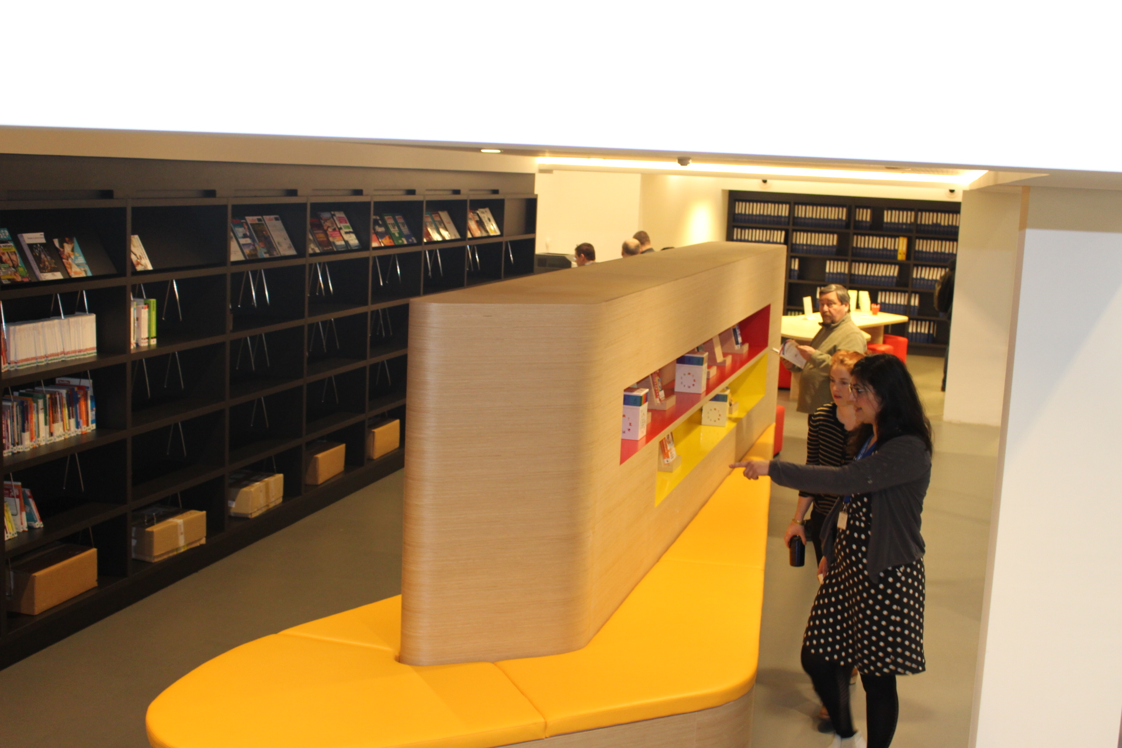
Advice and resources in one unique location
Documentation area

Slide 25
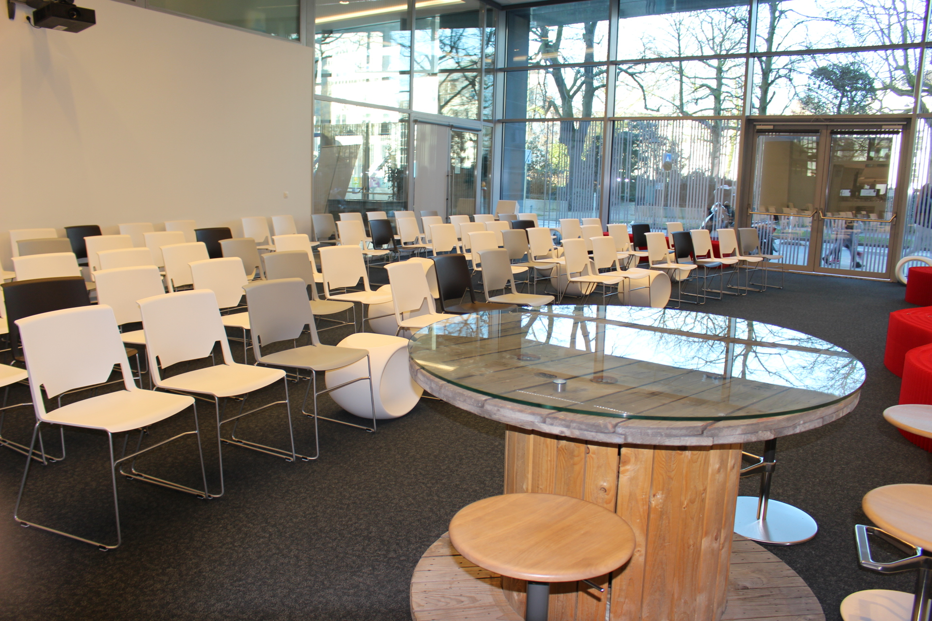
Advice and resources in one unique location
Large room for events or hosting groups

Slide 26
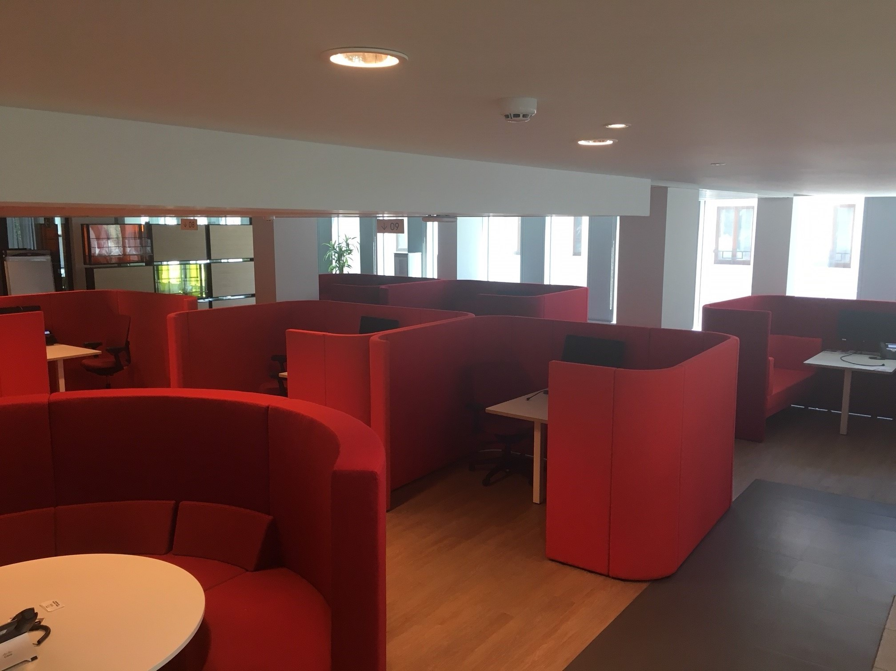
Advice and resources in one unique location
Area for personalized advice

Slide 27
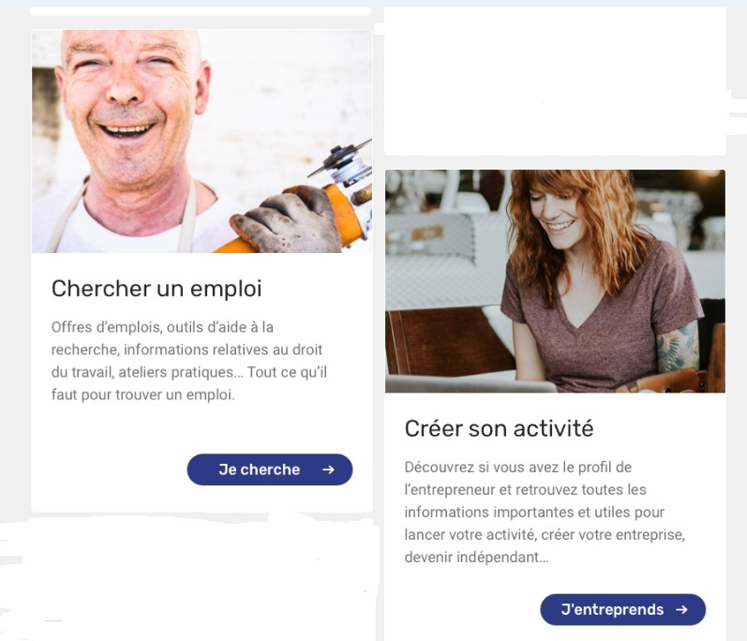
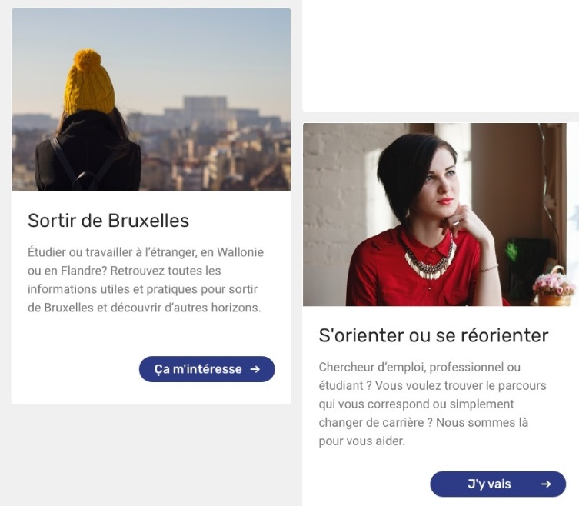
Virtual tour of the CDM through the website
Set up as self-employed
This new website includes information from the Dorifor and IMT-B sites.
Move

Slide 28
For more information, please contact...
Cité des Métiers Brussels
Avenue de l’Astronomie 14,
1210 Bruxelles
(Métro Madou)
www.citedesmetiers.brussels
Accessible from Monday to Friday from 9:30am to 4pm (except Thursday 1:30pm to 7pm)

Slide 29
Thank you!

